Slide 1

FINAL SUBMISSION
Capstone Project –
Blockchain Based Ticket Management
Mentor - Deepak Majjiga
Team –
Pinakin Purandare, Vishal Chawre, V Swaminathan, Madhavi Chopparapu

Slide 2
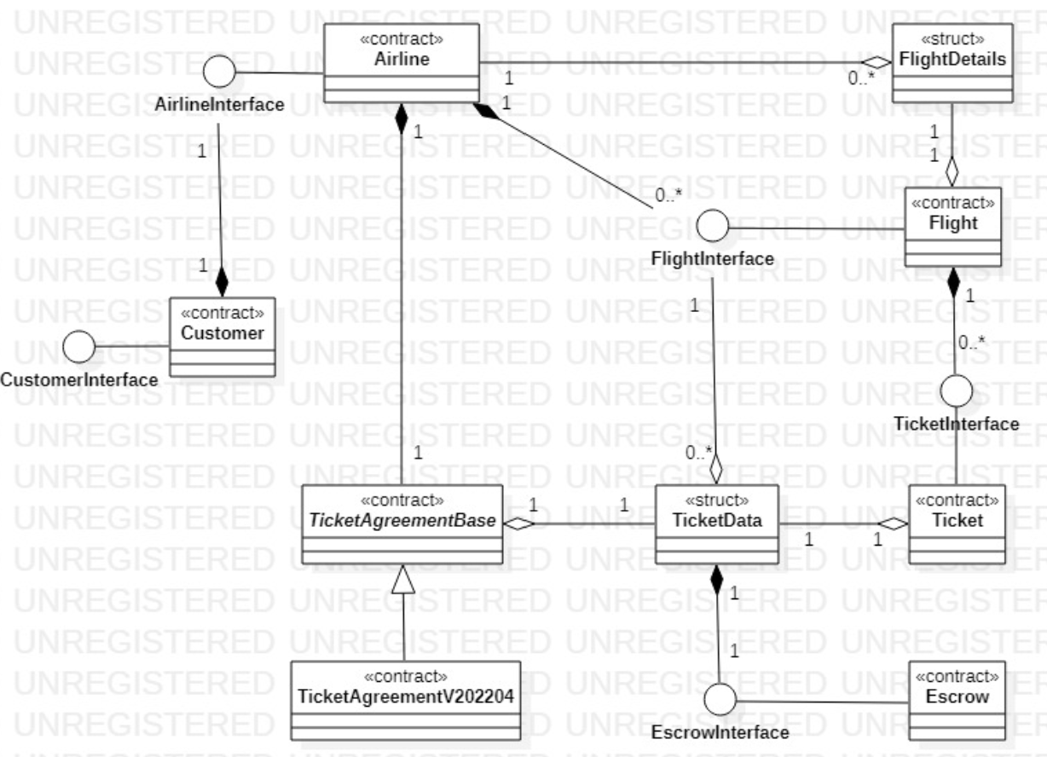
SMART Contracts

Slide 3
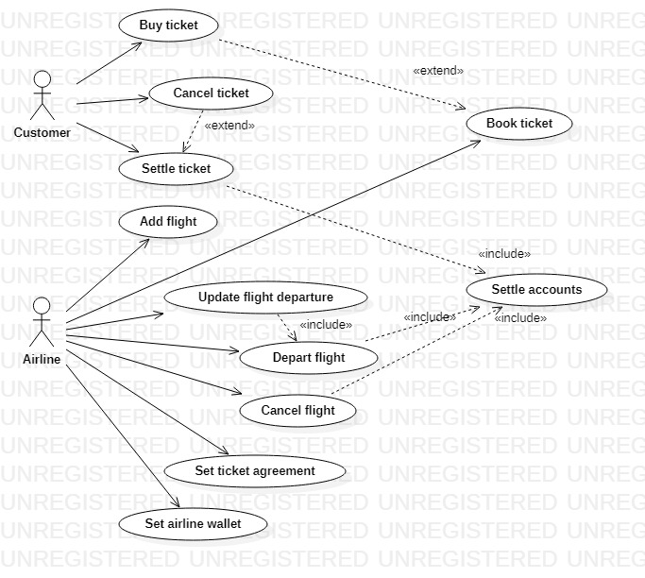
Actors & use cases

Slide 4
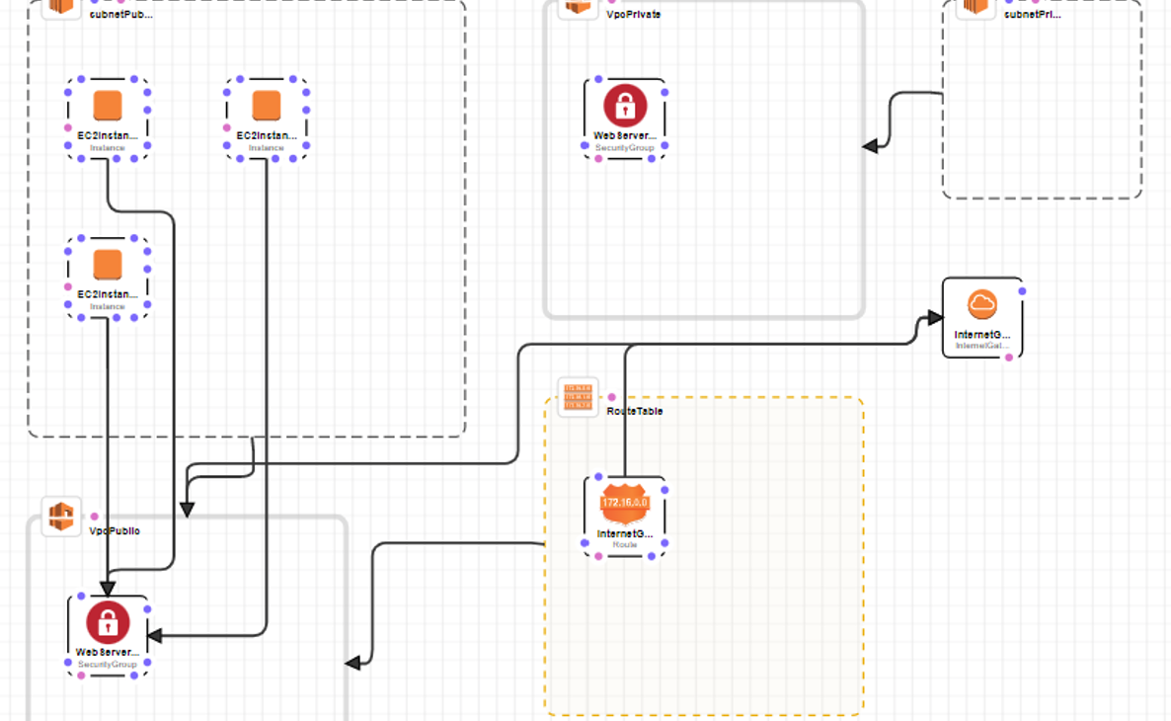
Blockchain Infra - cloud

Slide 5

Blockchain Infra - GETH
(Boot Node)
EC2 Machine 1
EC2 Machine 2
EC2 Machine 3
Vishal - Customer Account
Swami - Customer Account
Pinakin - Customer Account
Madhavi - Customer Account
EagleAccount1- Sealer Account
EagleAccount2- Sealer Account
Escrow Account
(Smart Contract)

Slide 6
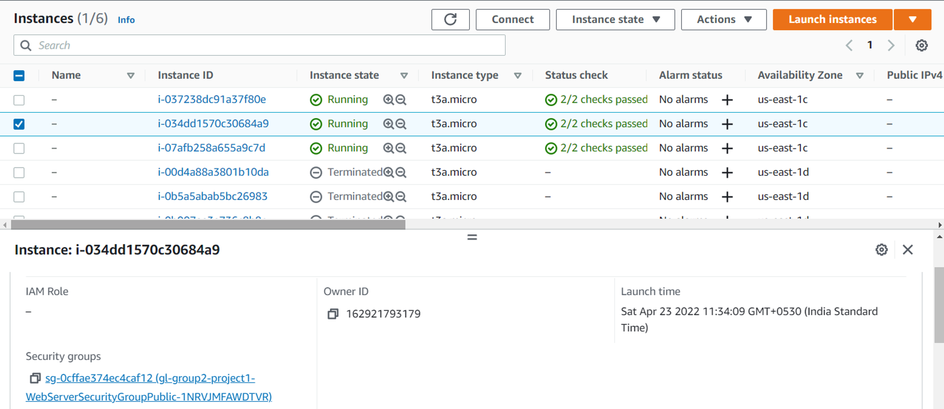
EC2 Instances – Boot and Geth Nodes

Slide 7
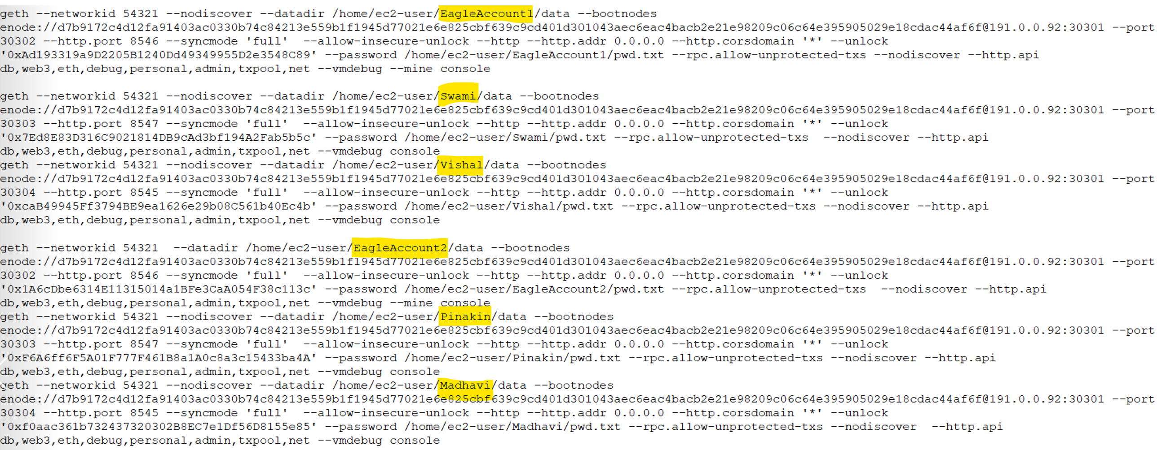
Geth Accounts start Commands

Slide 8
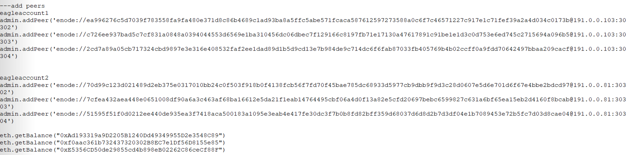
Add peers, checking balance and send txn

Slide 9
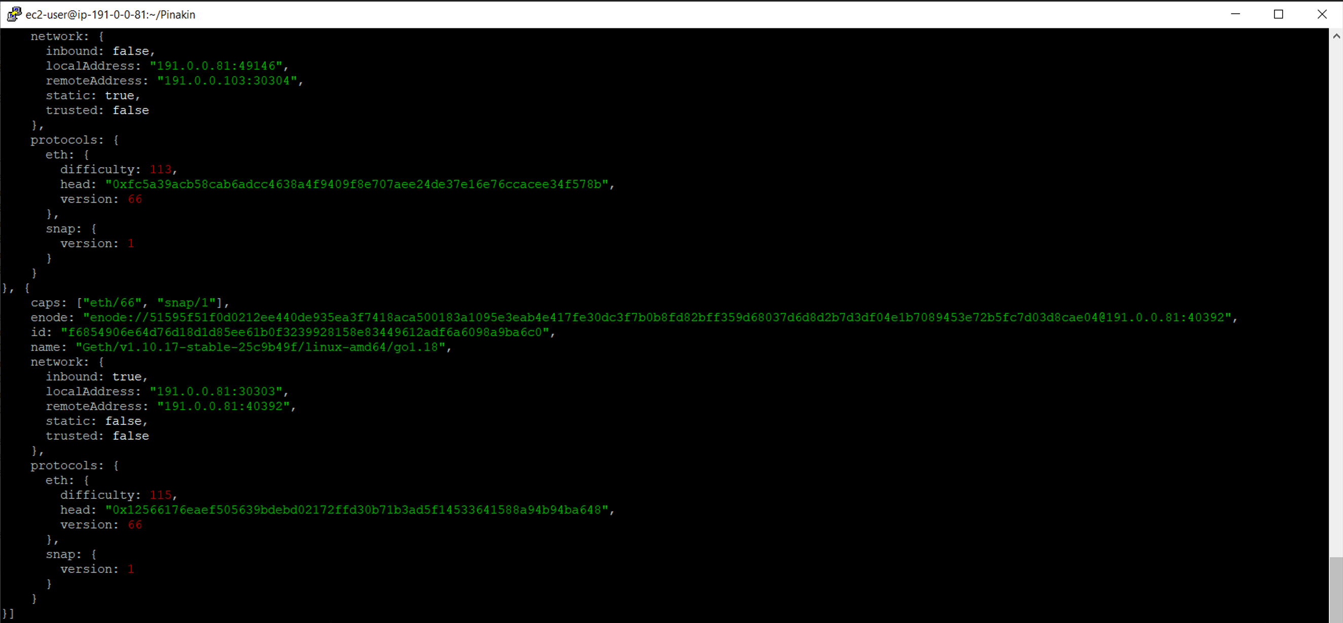
verify peers

Slide 10
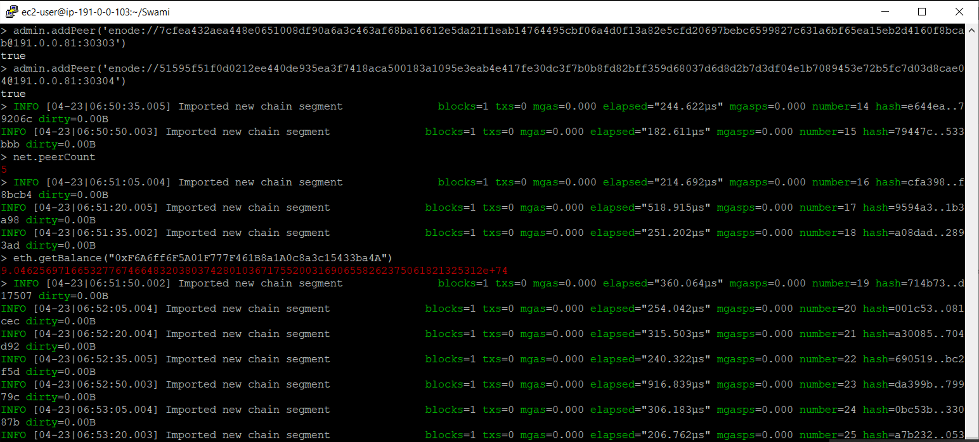
GET balance – Same Ec2 Machine

Slide 11
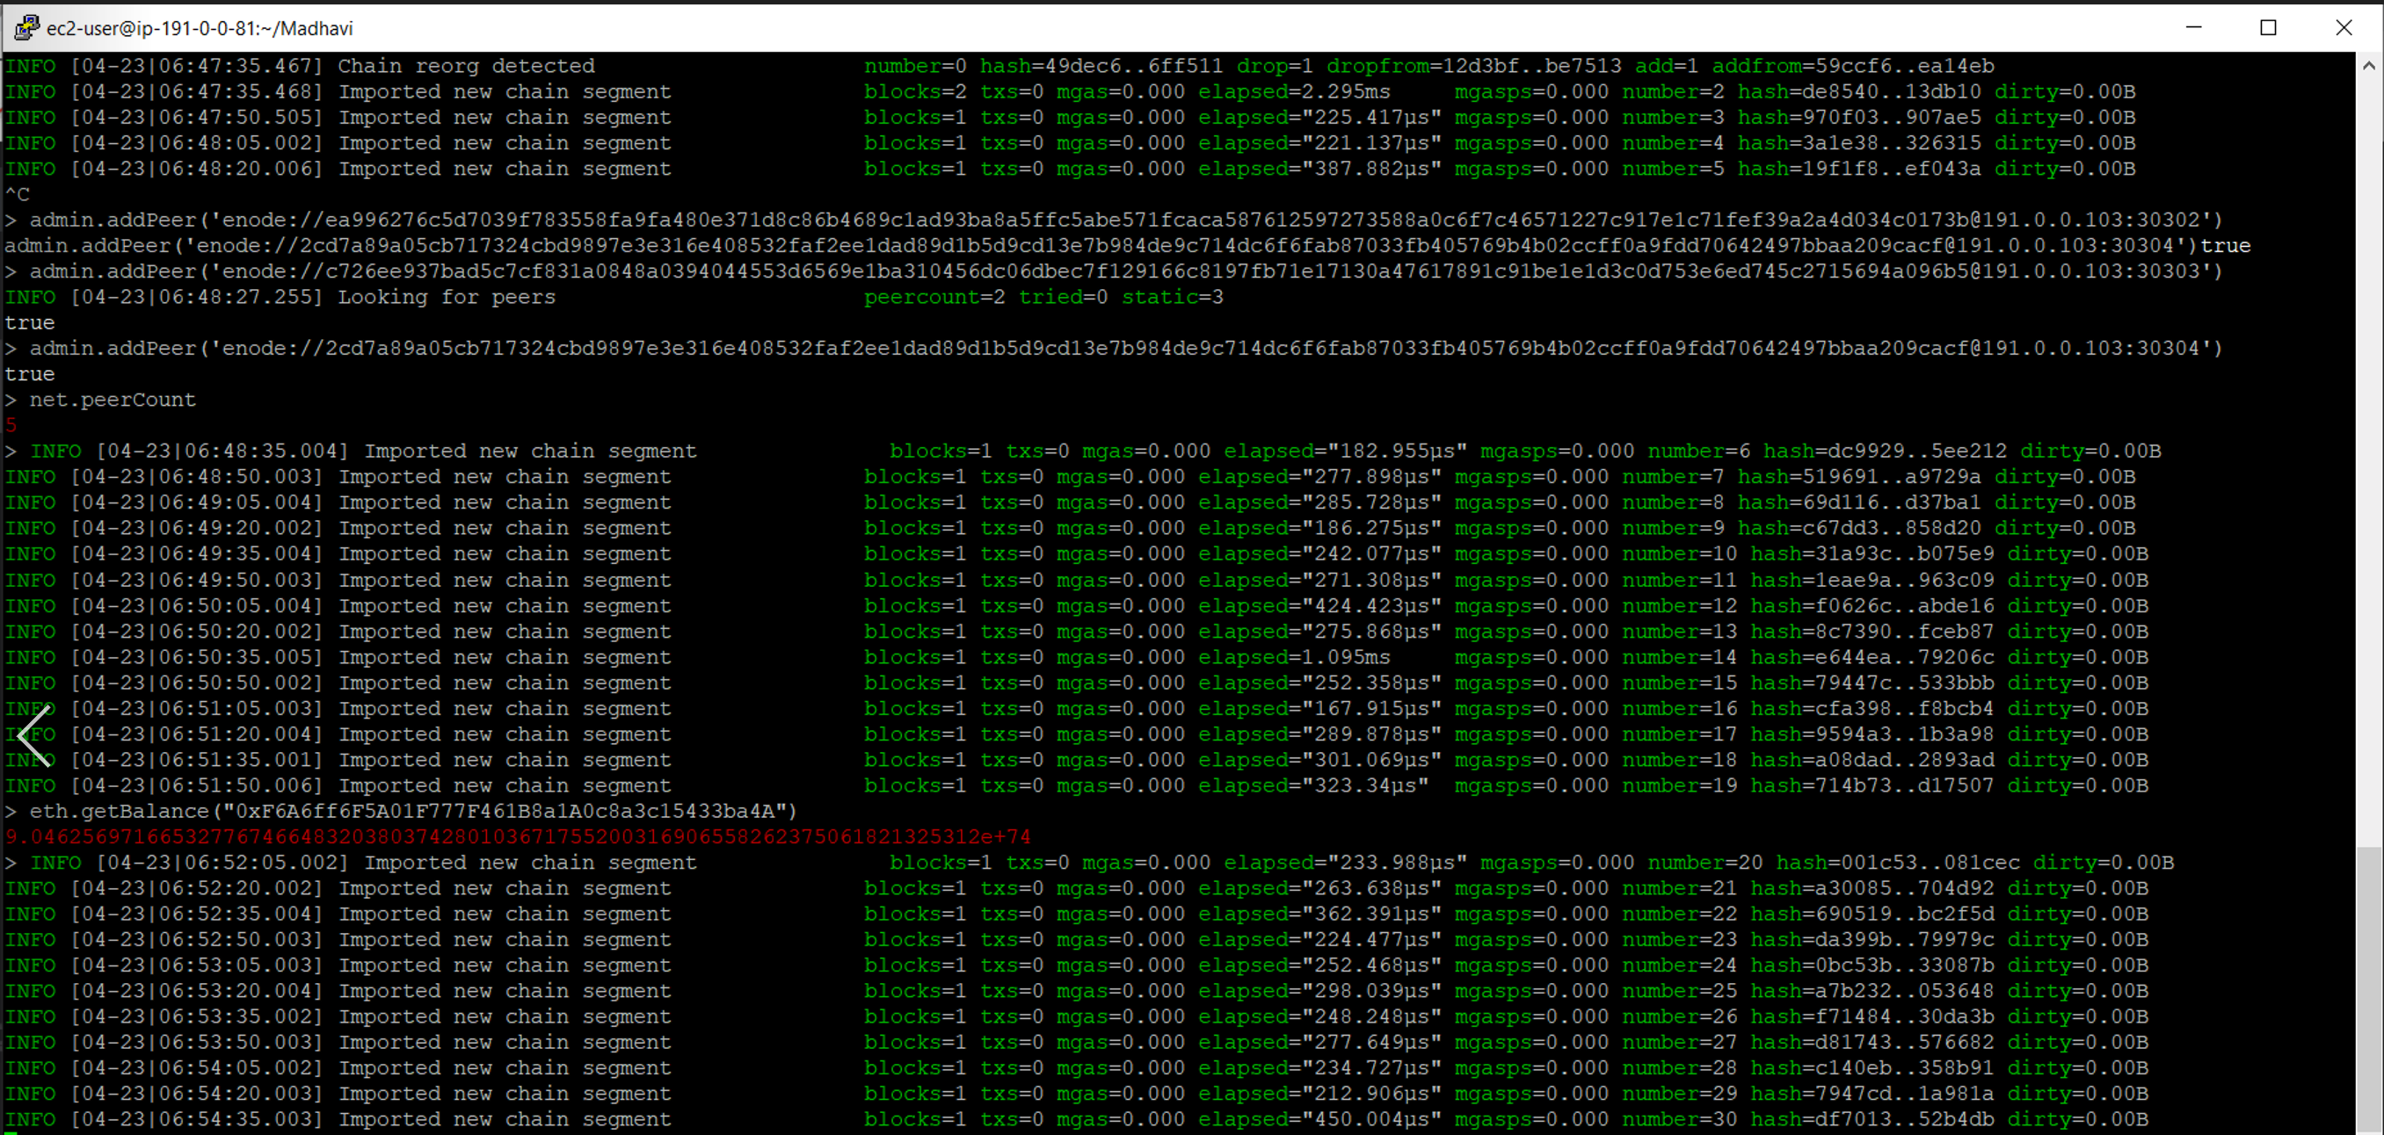
GET balance – Different Ec2 Machine

Slide 12
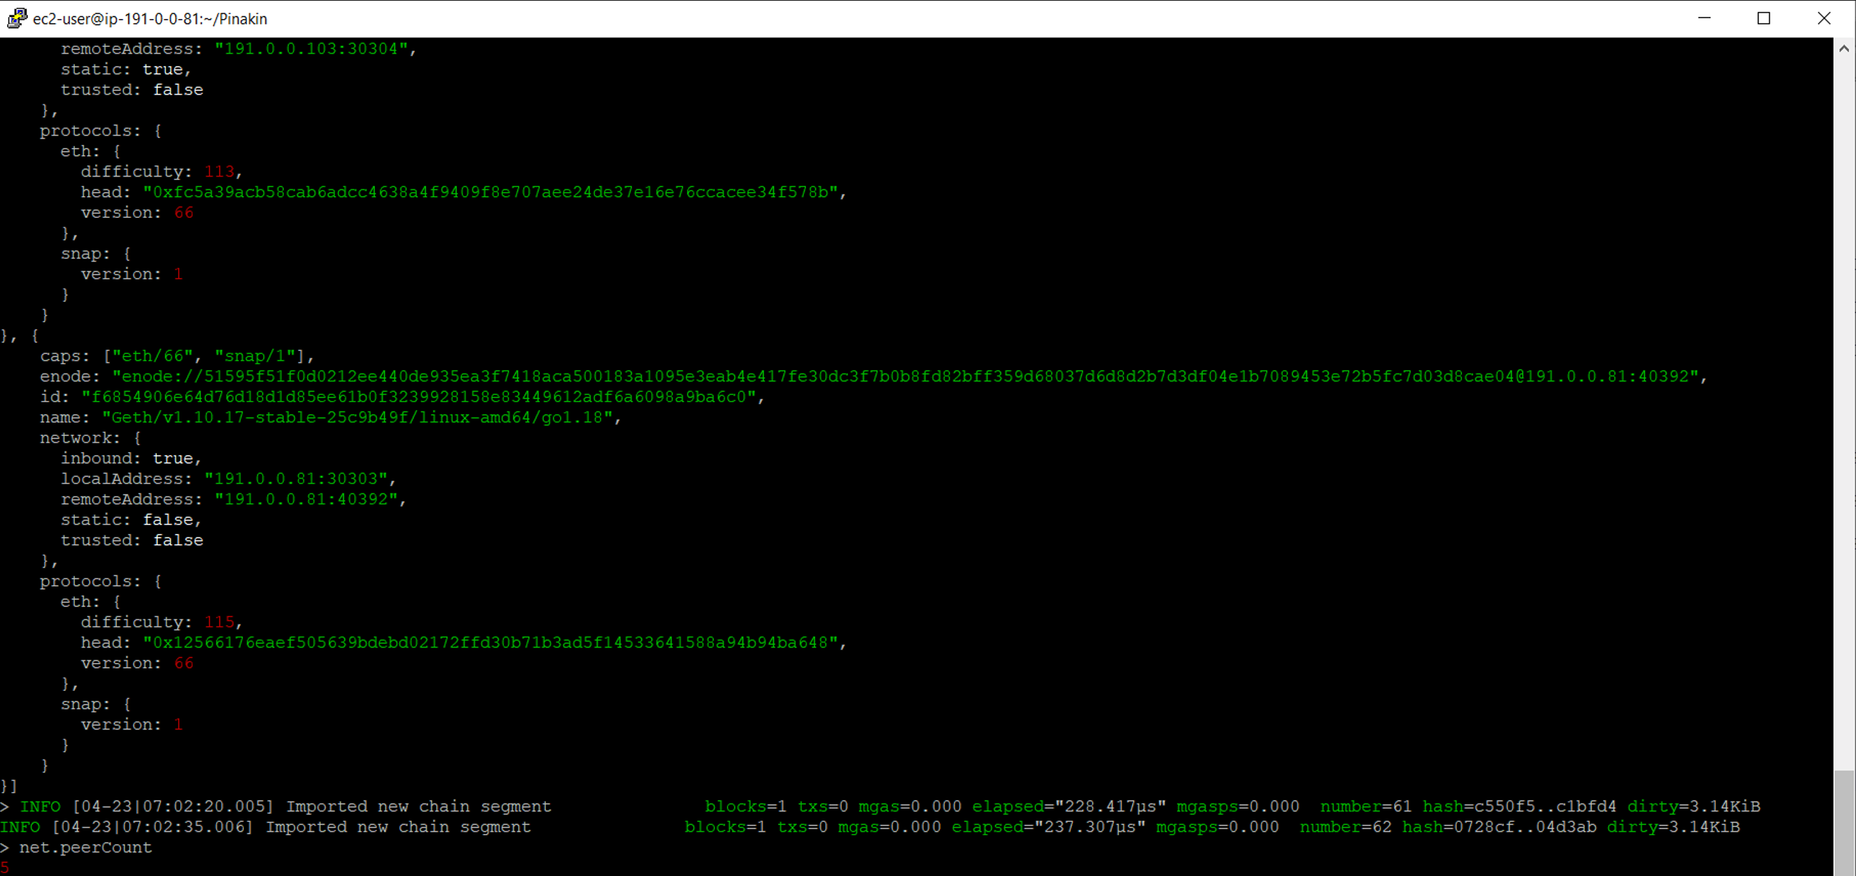
Checking Peer Count

Slide 13
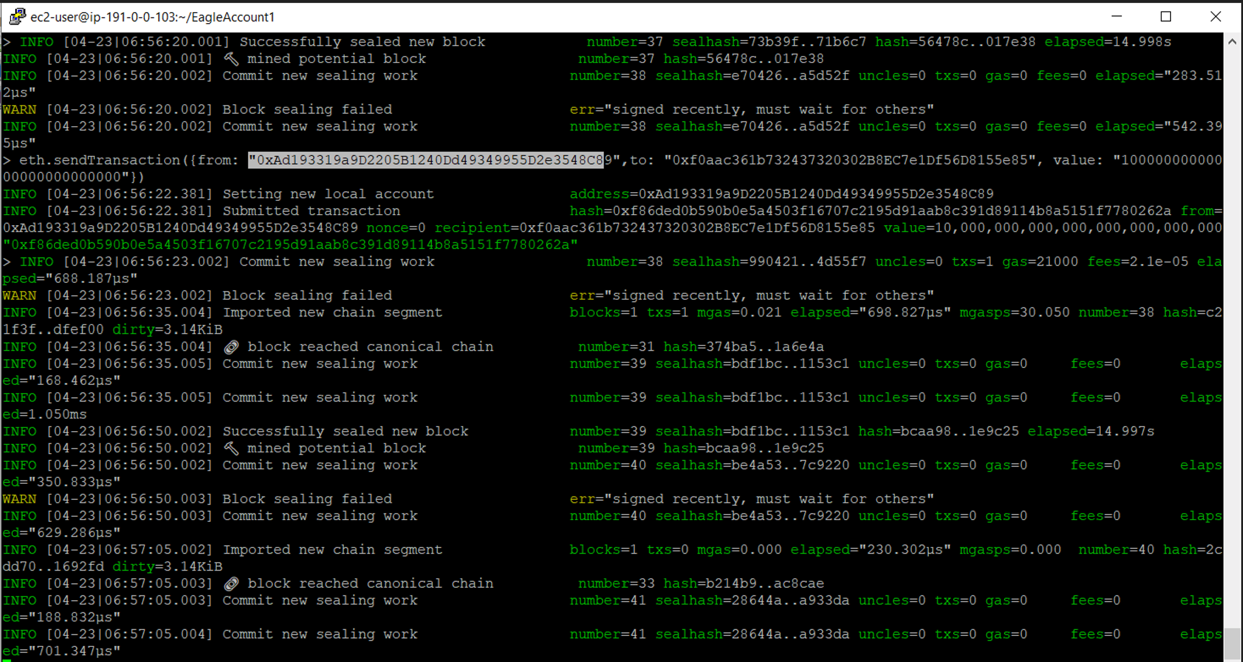
Send TxN with Different ec2 geth account
GET balance

Slide 14
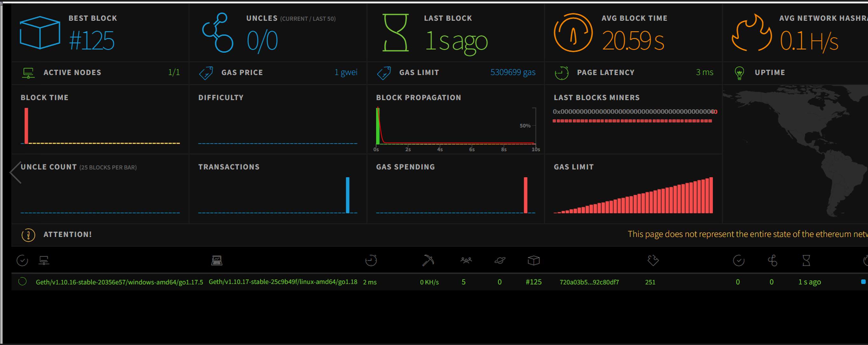
Dashboard – Blockchain Network Monitoring

Slide 15
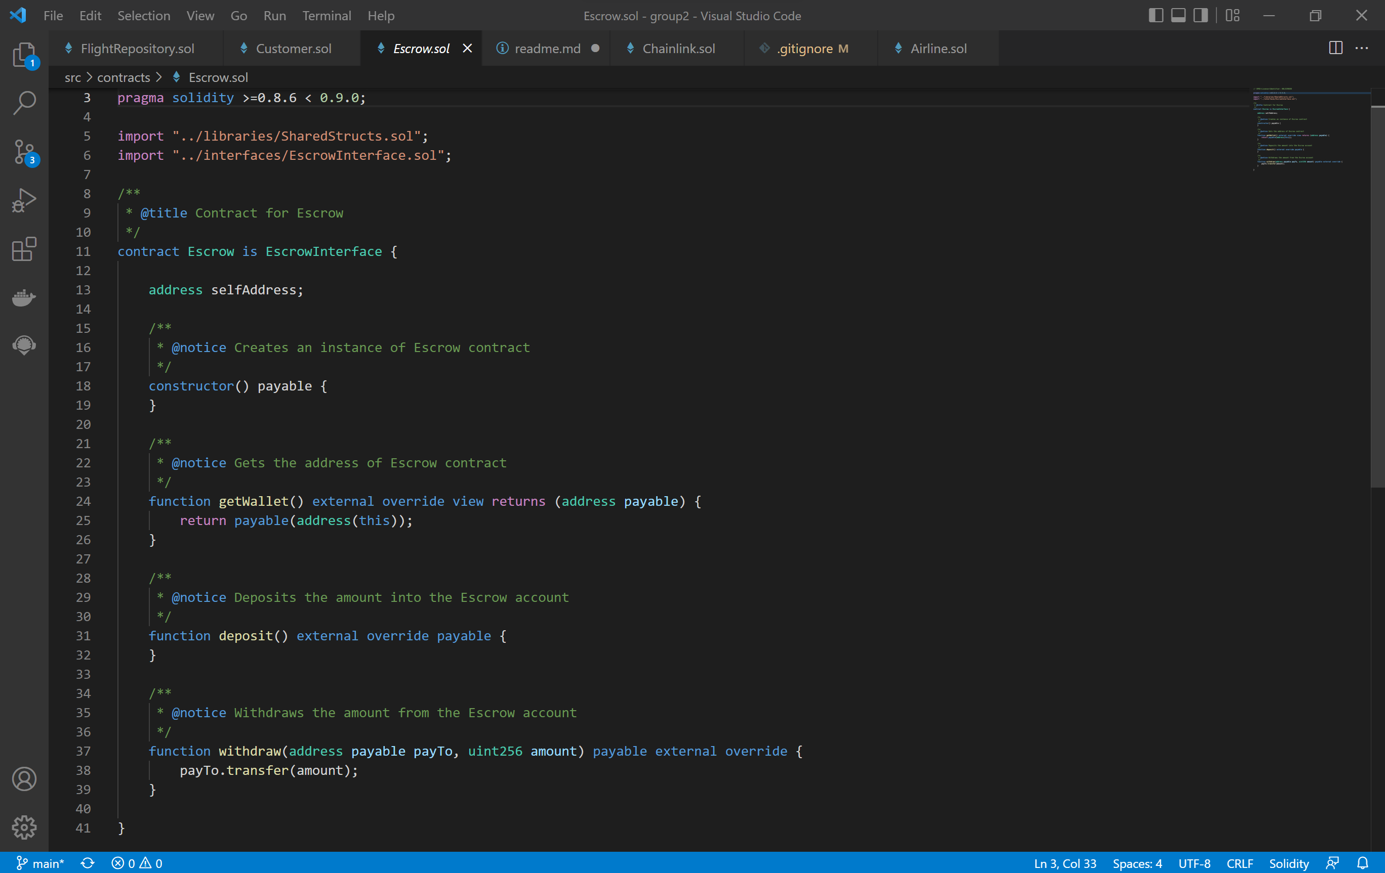
ESCROW SMART CONTRACT CODE

Slide 16
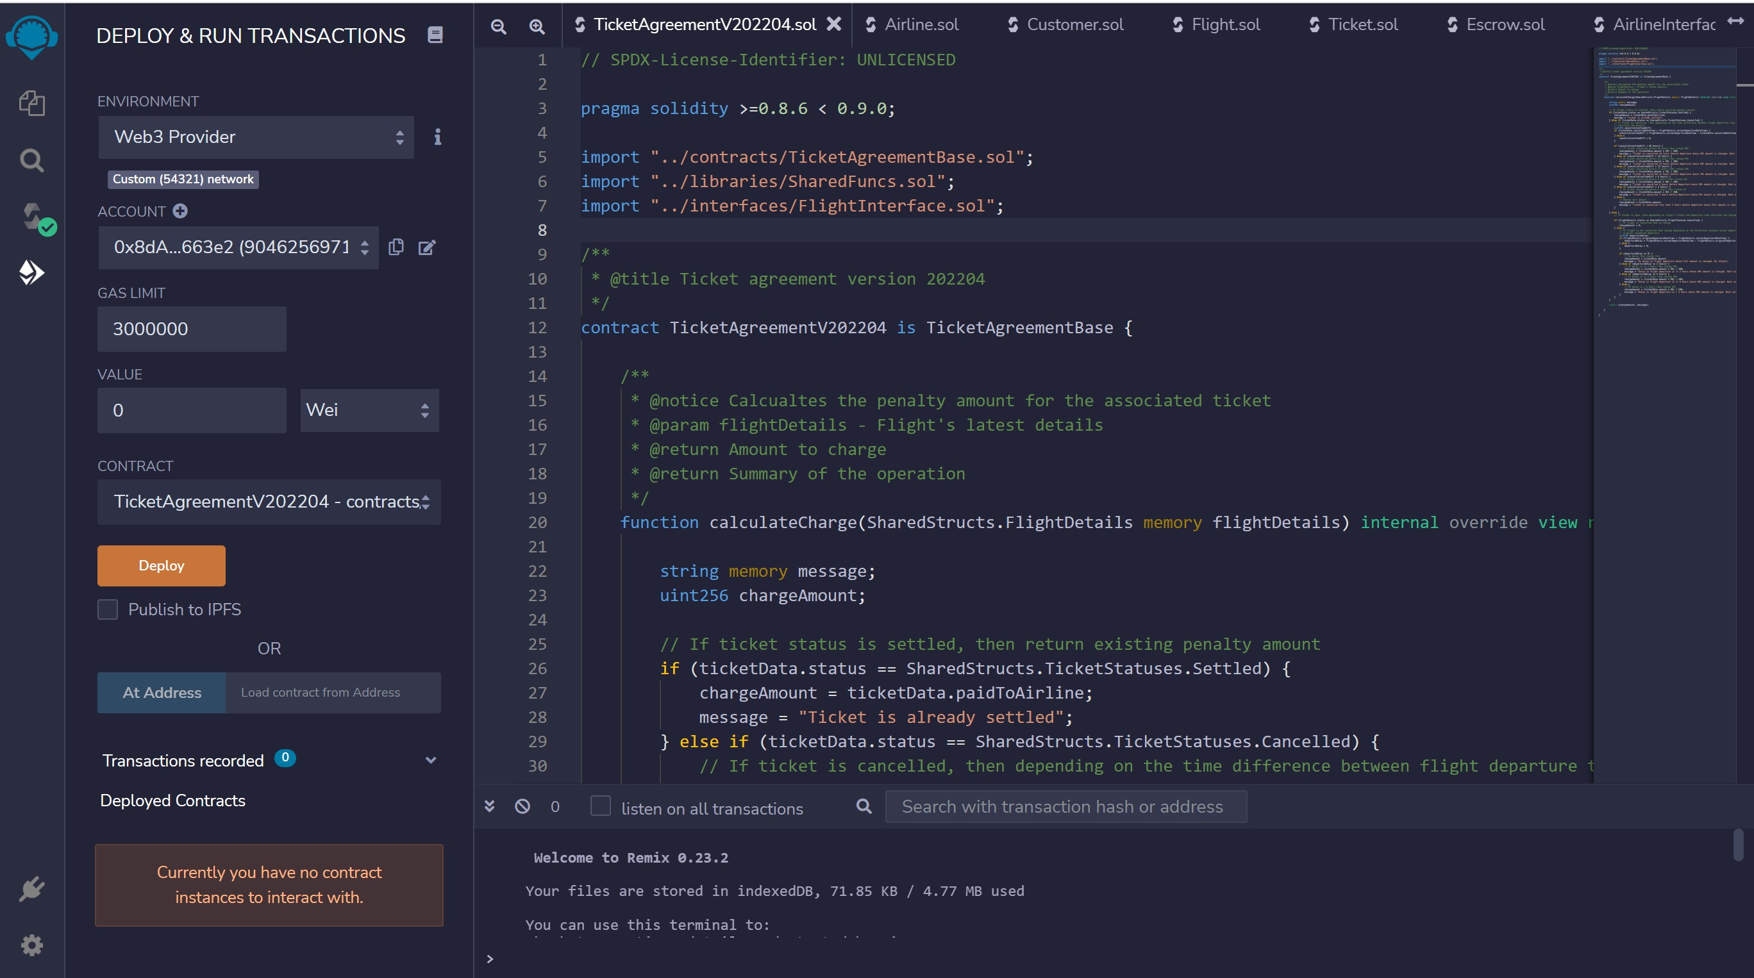
CONNECT TO NETWORK WITH AIRLINE A/C MINER 1

Slide 17
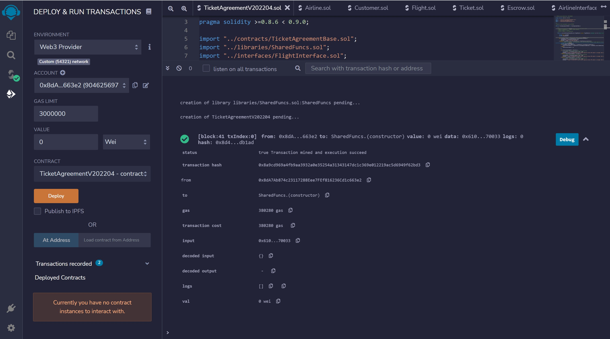
DEPLOY TICKET AGREEMENT CONTRACT

Slide 18
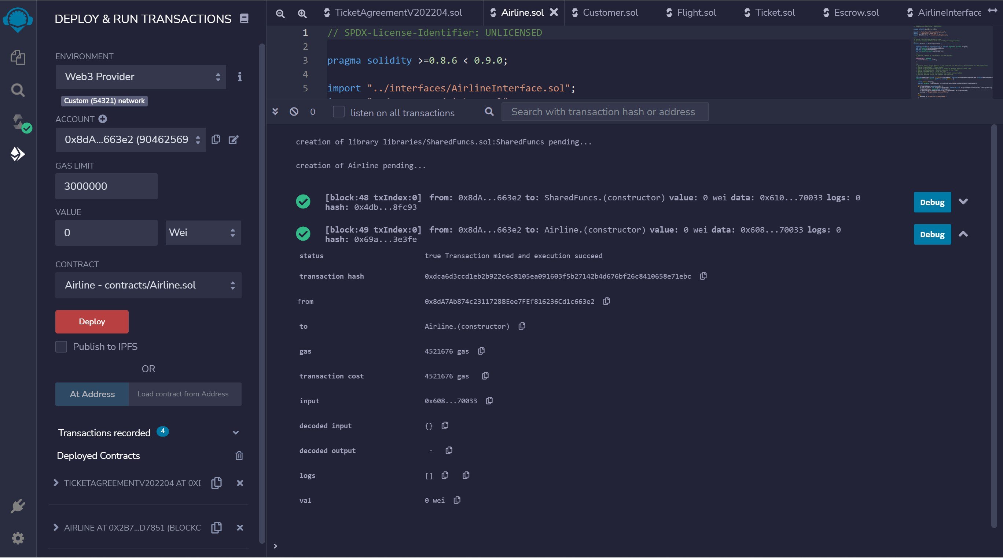
DEPLOY AIRLINE CONTRACT

Slide 19
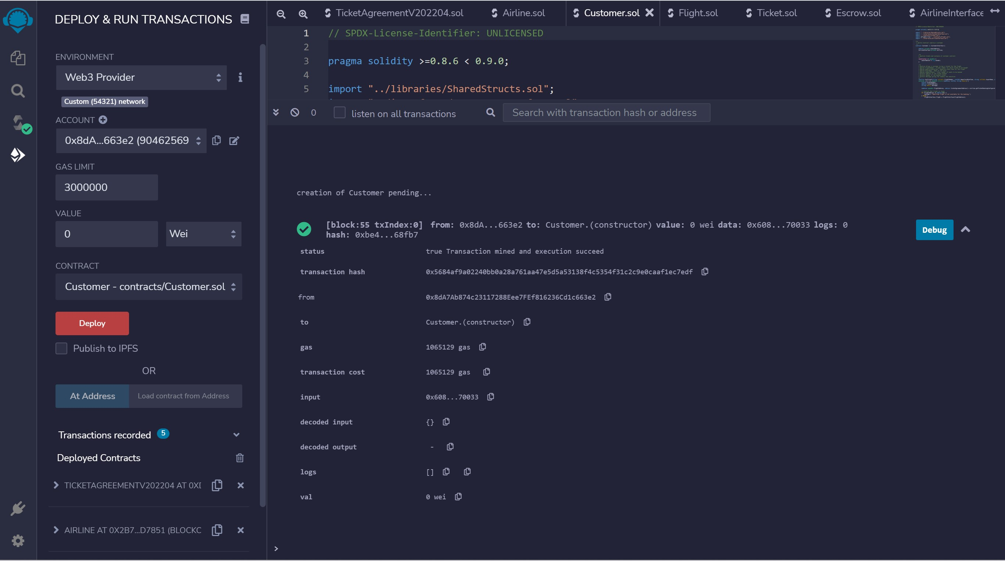
DEPLOY CUSTOMER CONTRACT

Slide 20
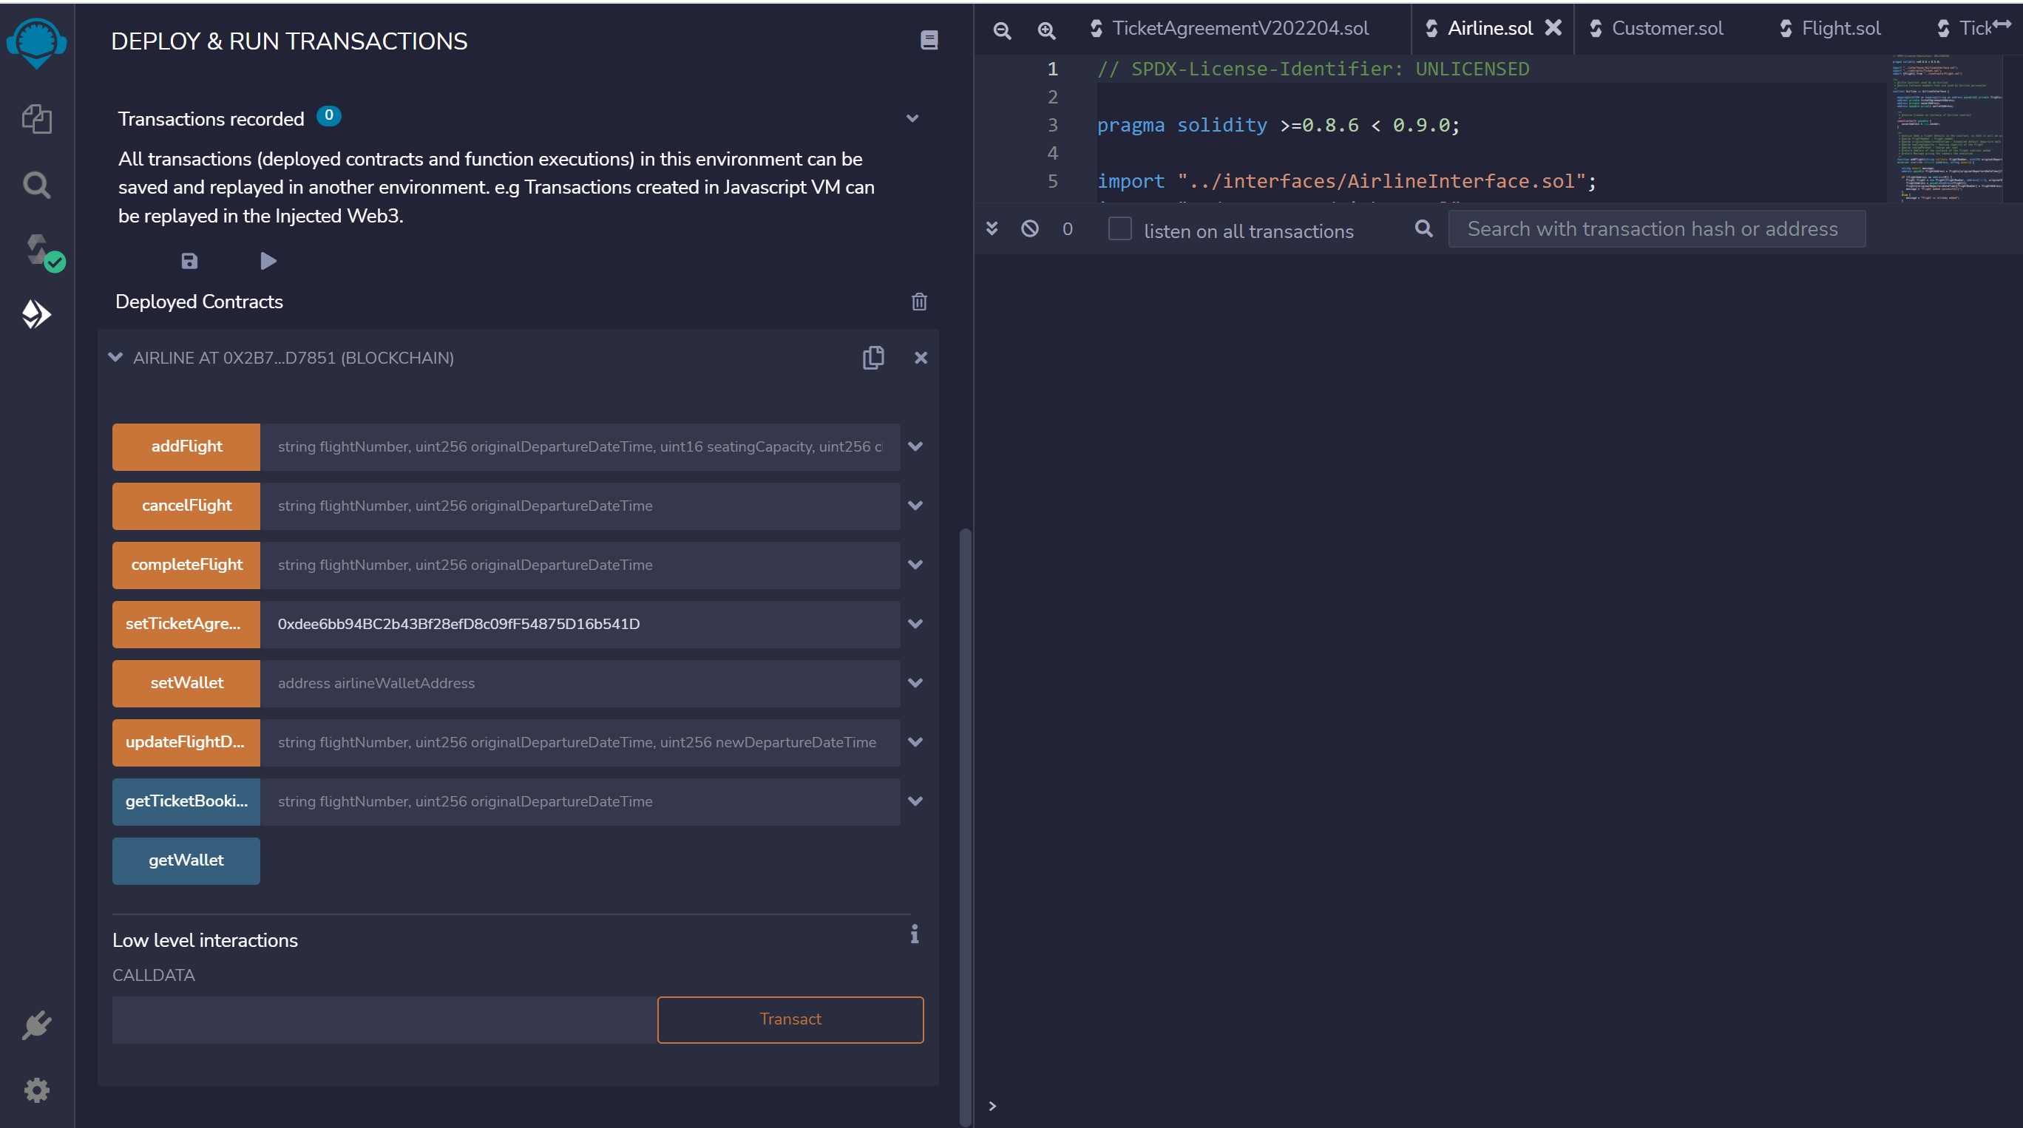
SET TICKET AGREEMENT

Slide 21
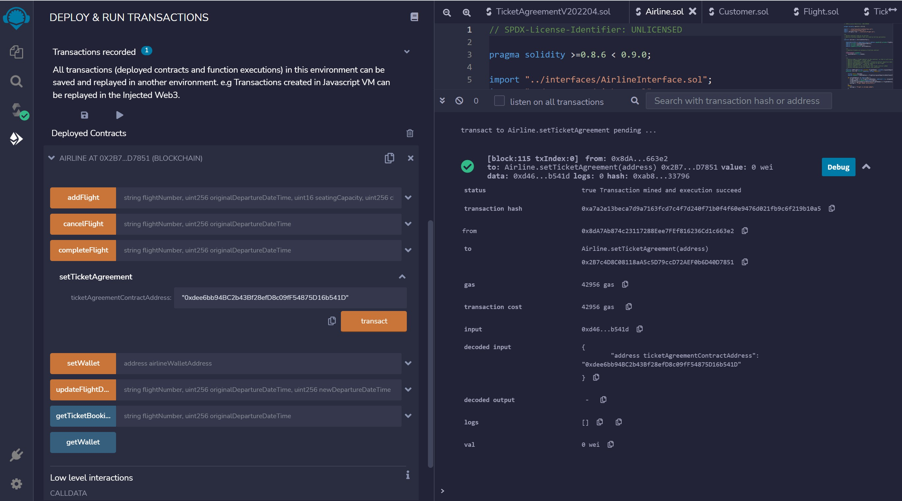
SET TICKET AGREEMENT - TXN

Slide 22
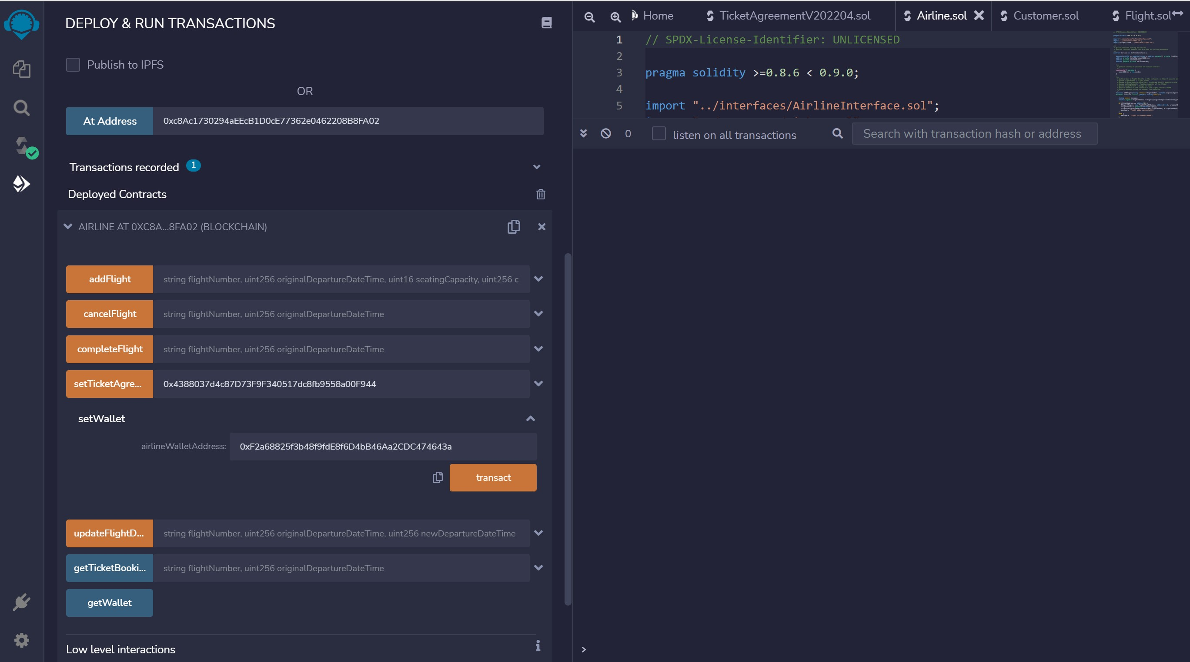
SET WALLET – AIRLINE ACCOUNT MINER 2

Slide 23
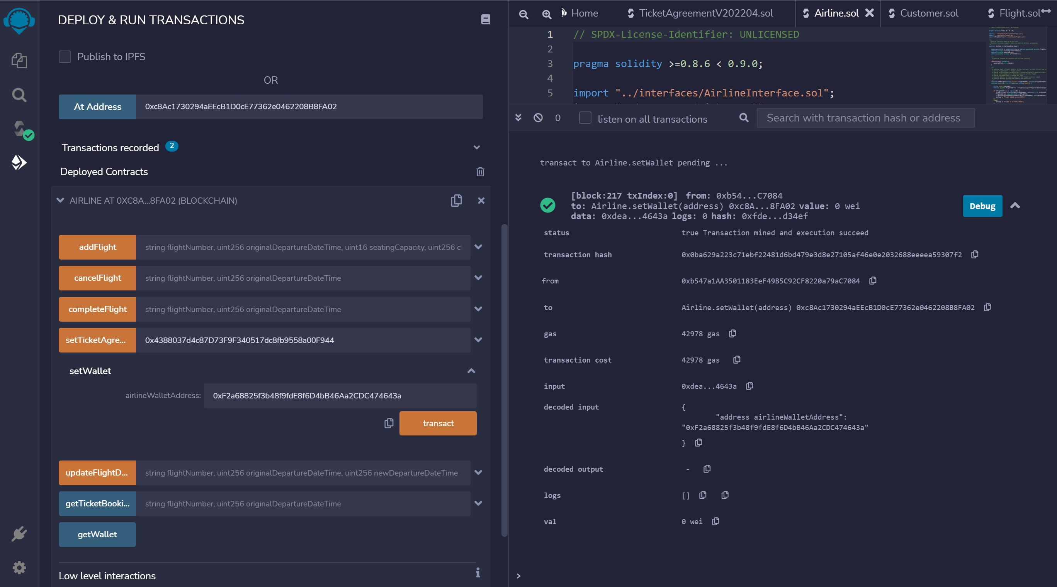
SET WALLET – AIRLINE ACCOUNT MINER 2 - TXN

Slide 24
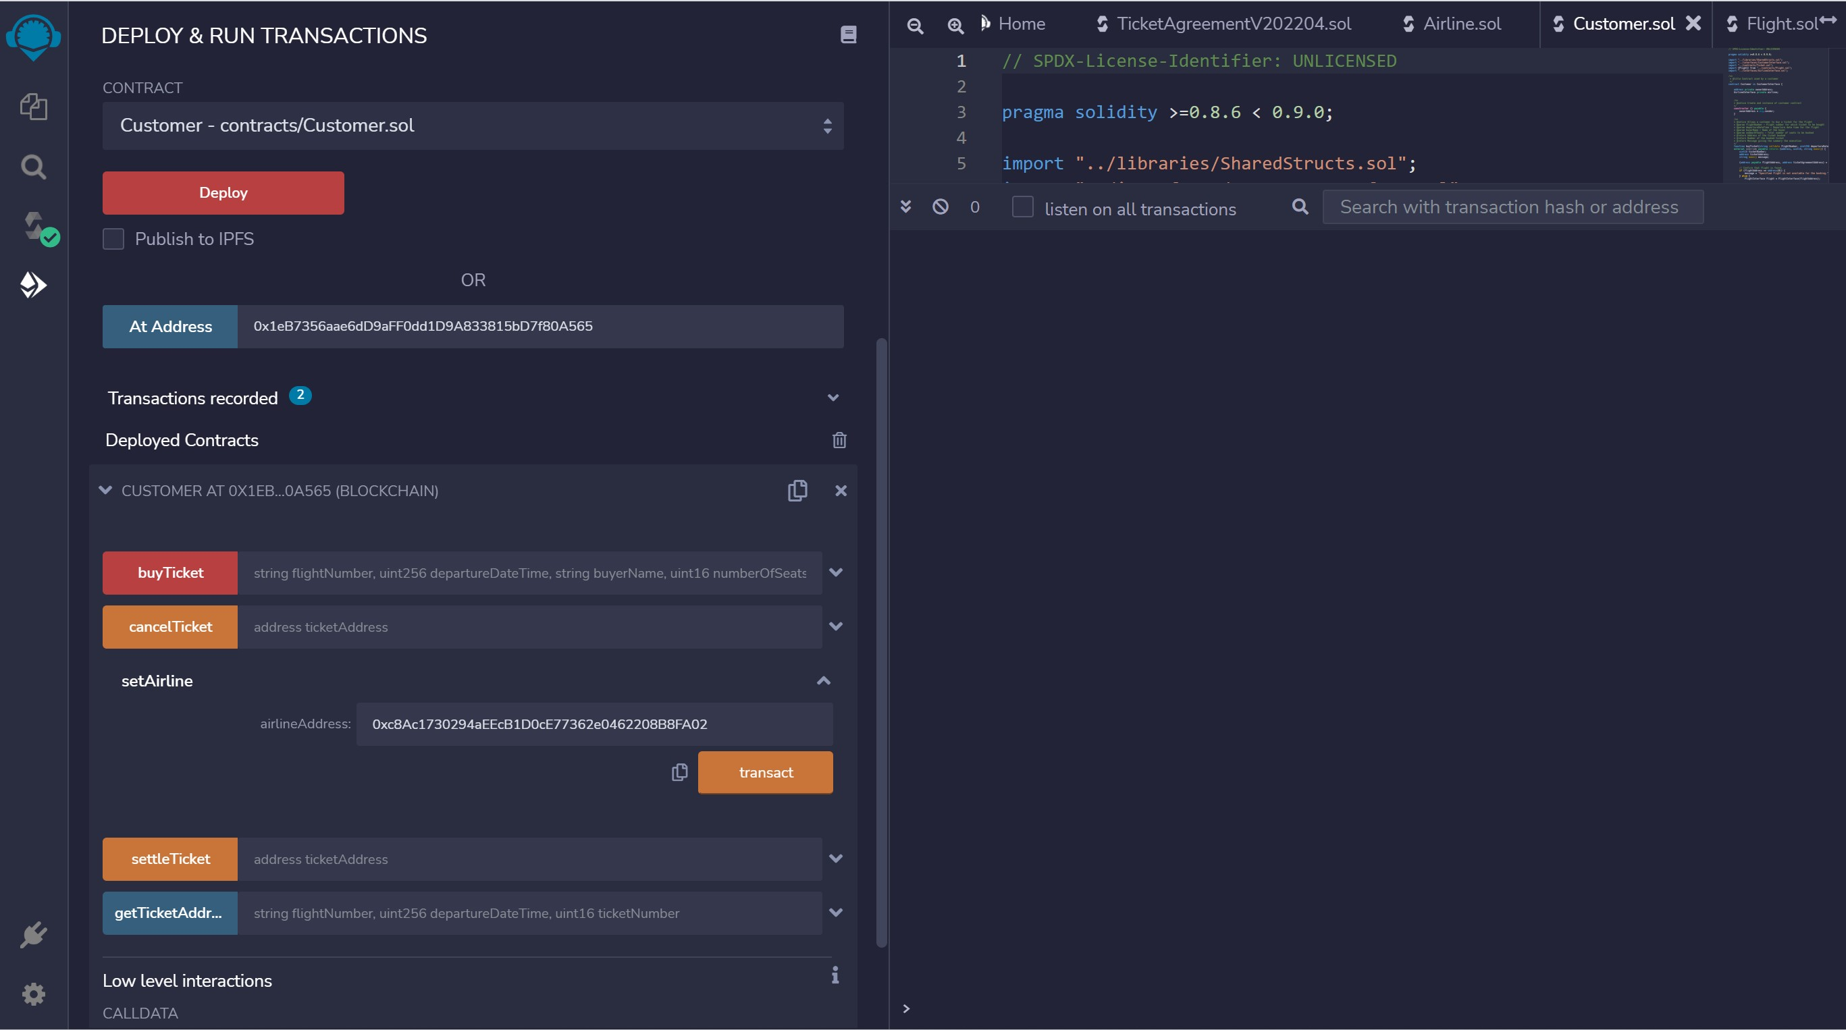
CUSTOMER – SET AIRLINE

Slide 25
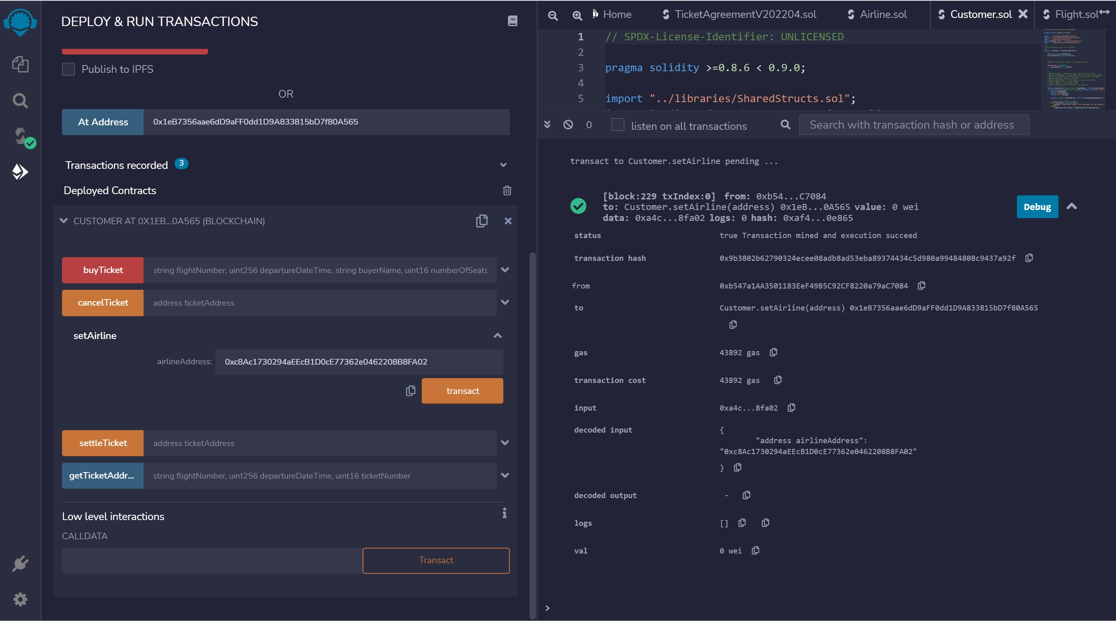
CUSTOMER – SET AIRLINE - TXN

Slide 26
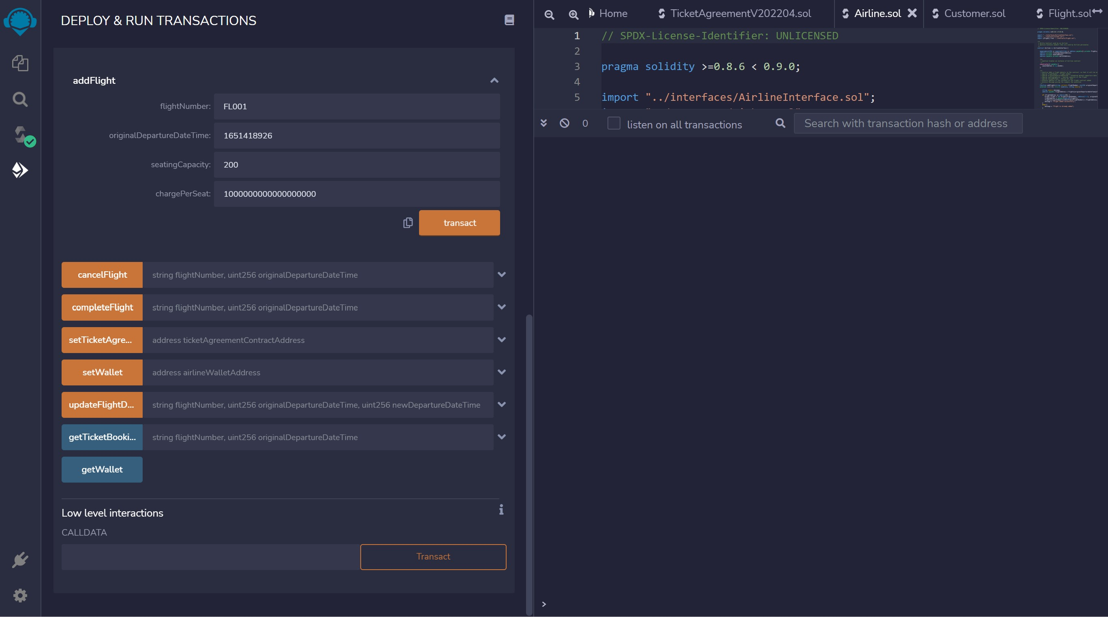
AIRLINE – ADD FLIGHT

Slide 27
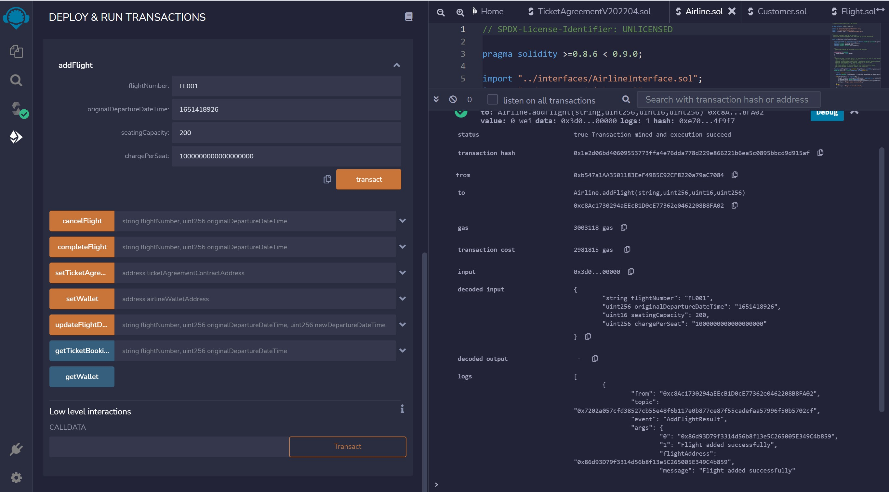
AIRLINE – ADD FLIGHT - TXN

Slide 28
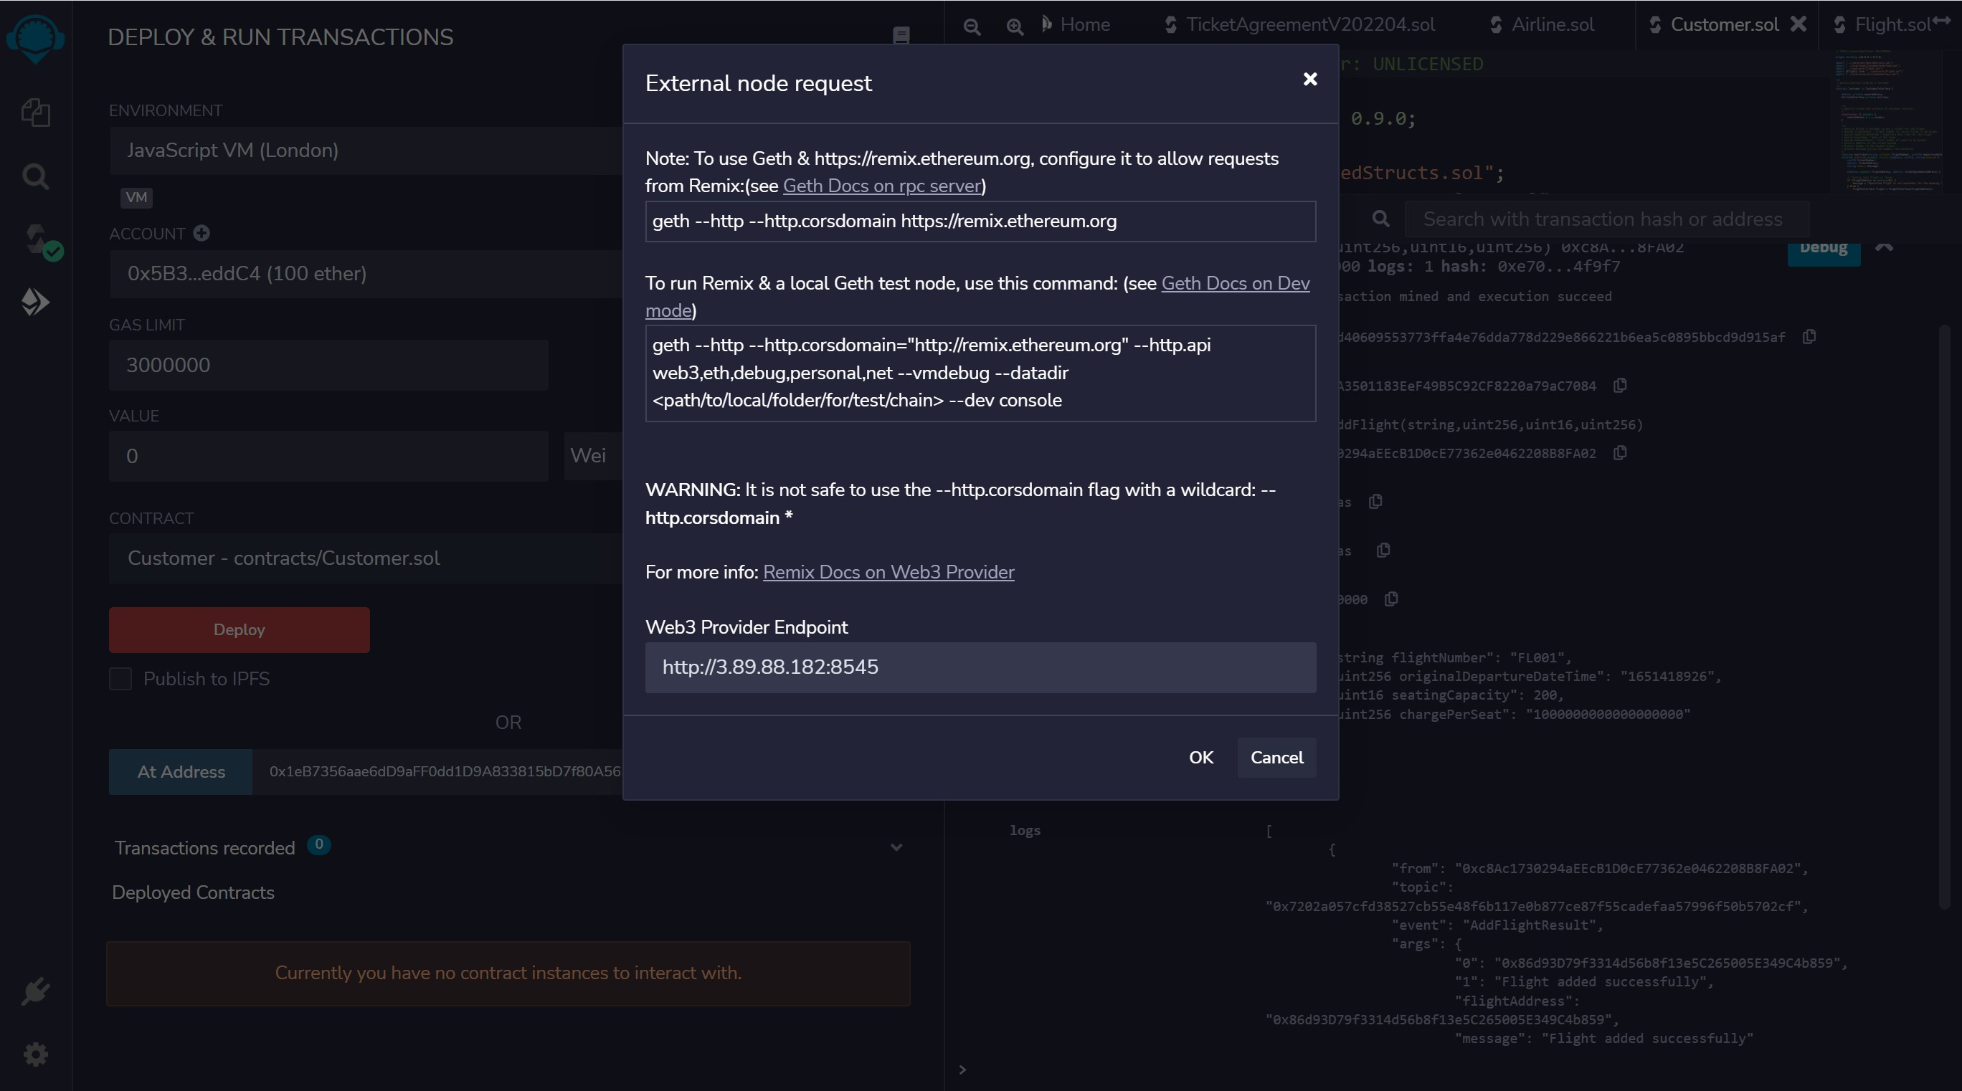
CONNECT TO CUSTOMER ACCOUNT

Slide 29
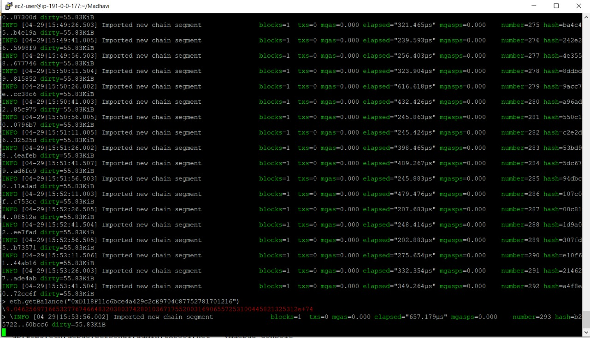
CUSTOMER BALANCE

Slide 30
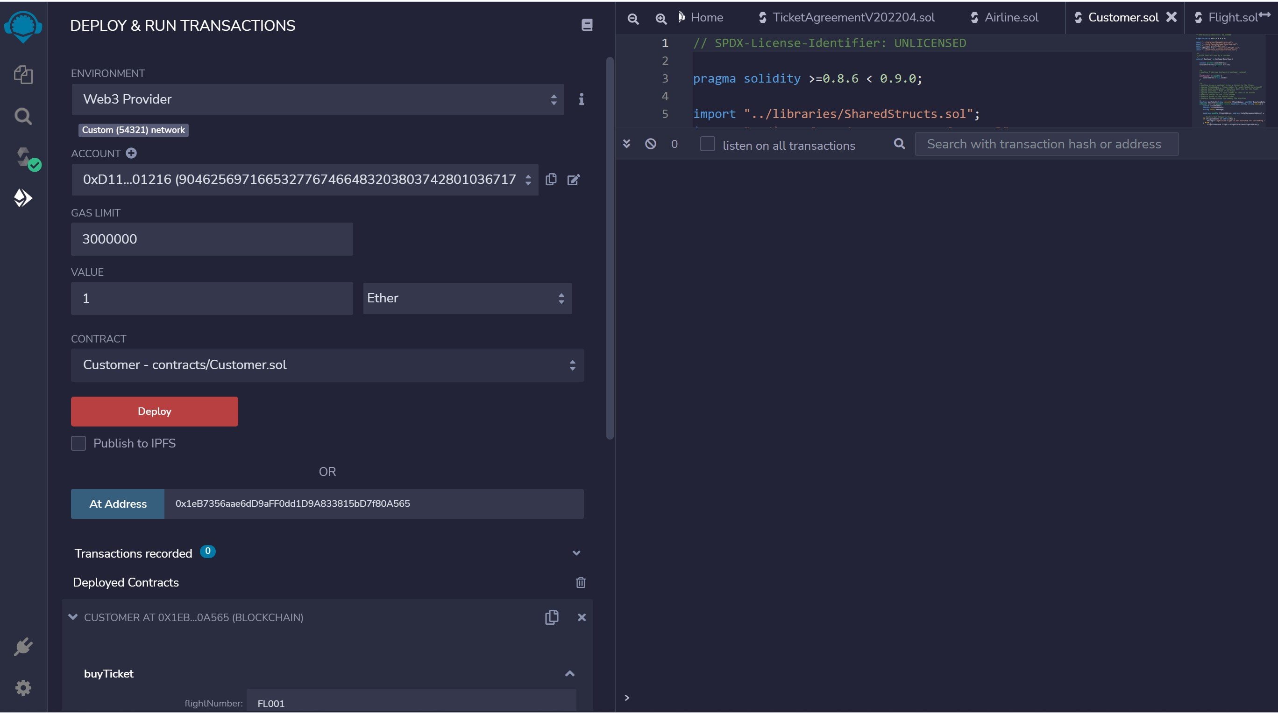
SET TXN AMOUNT TO 1 ETH

Slide 31
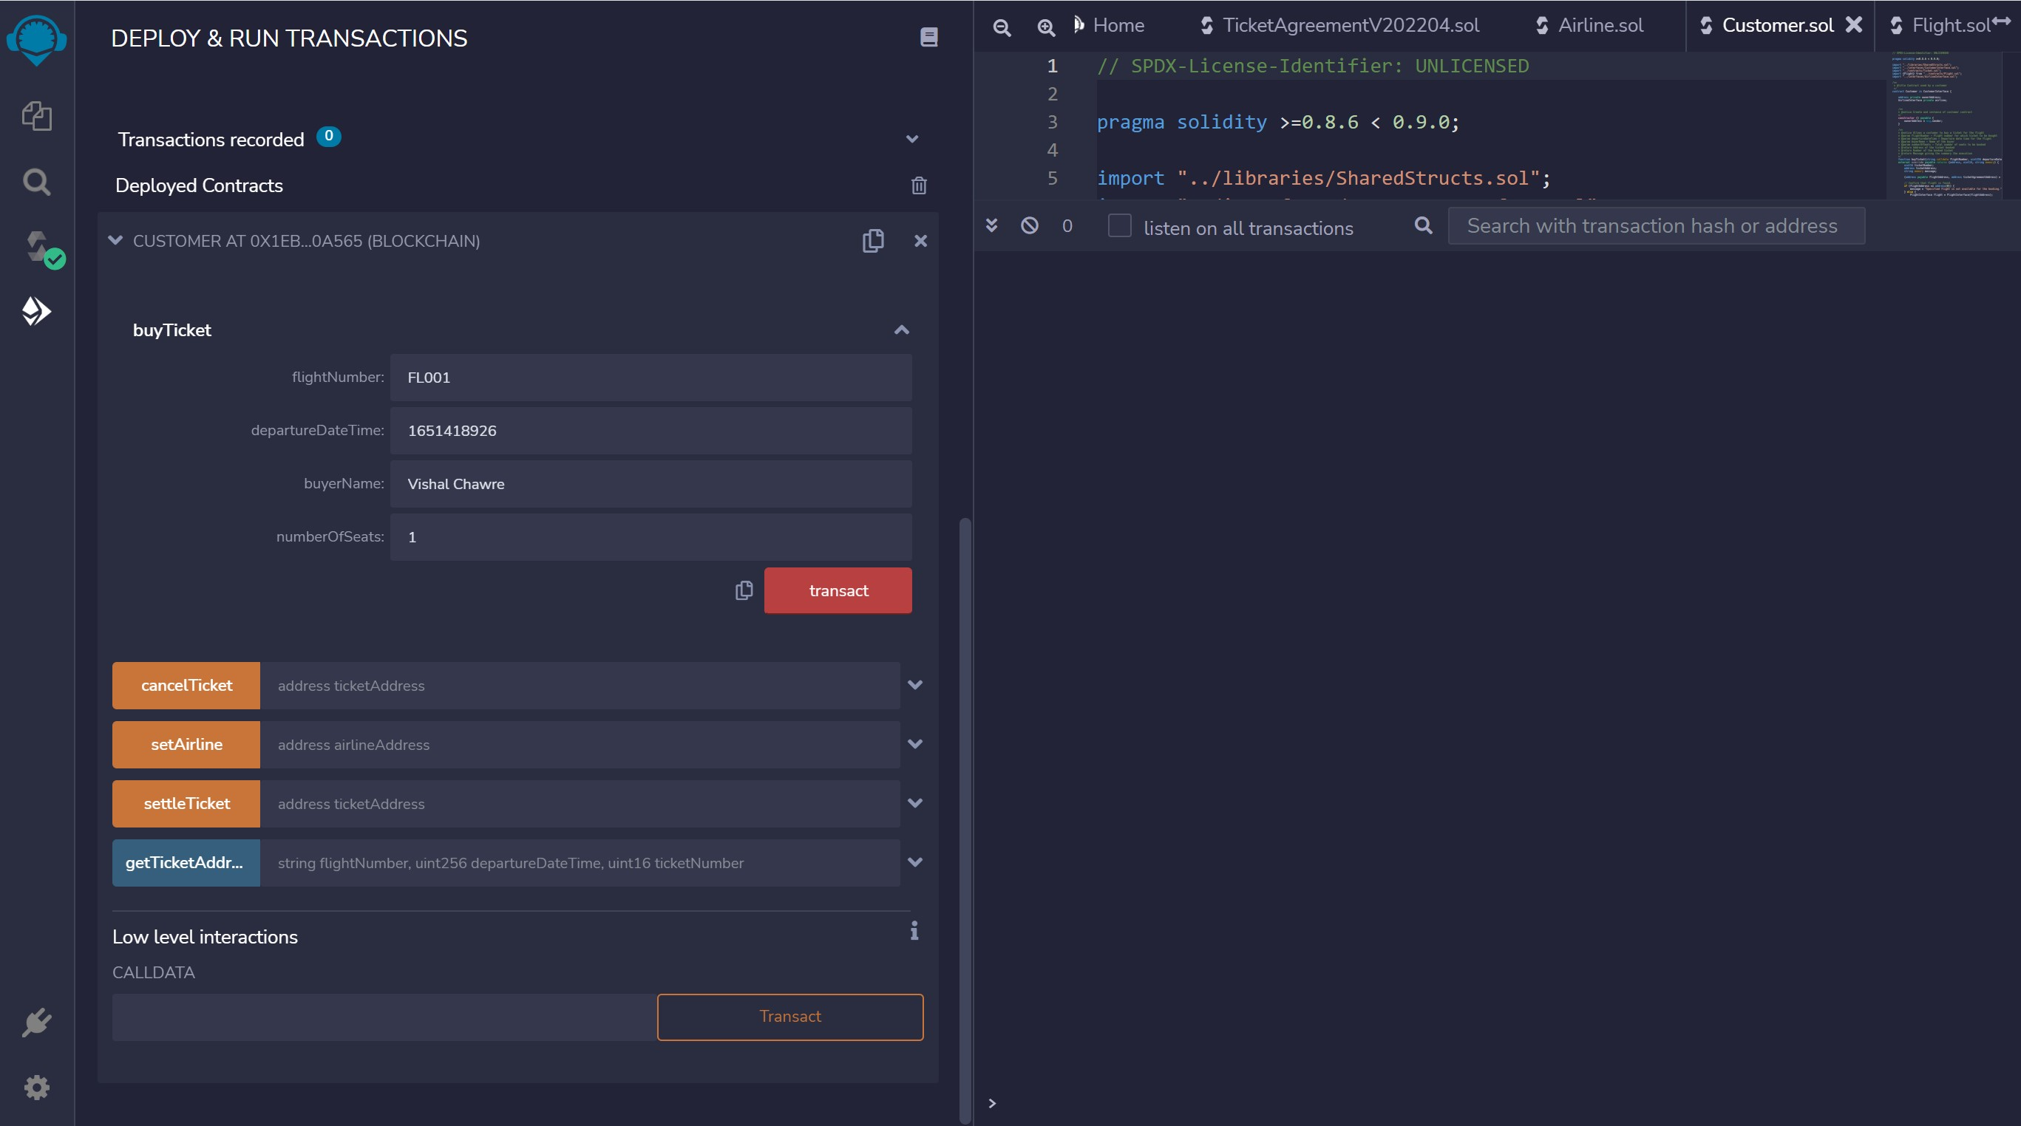
CUSTOMER BUY TICKET

Slide 32
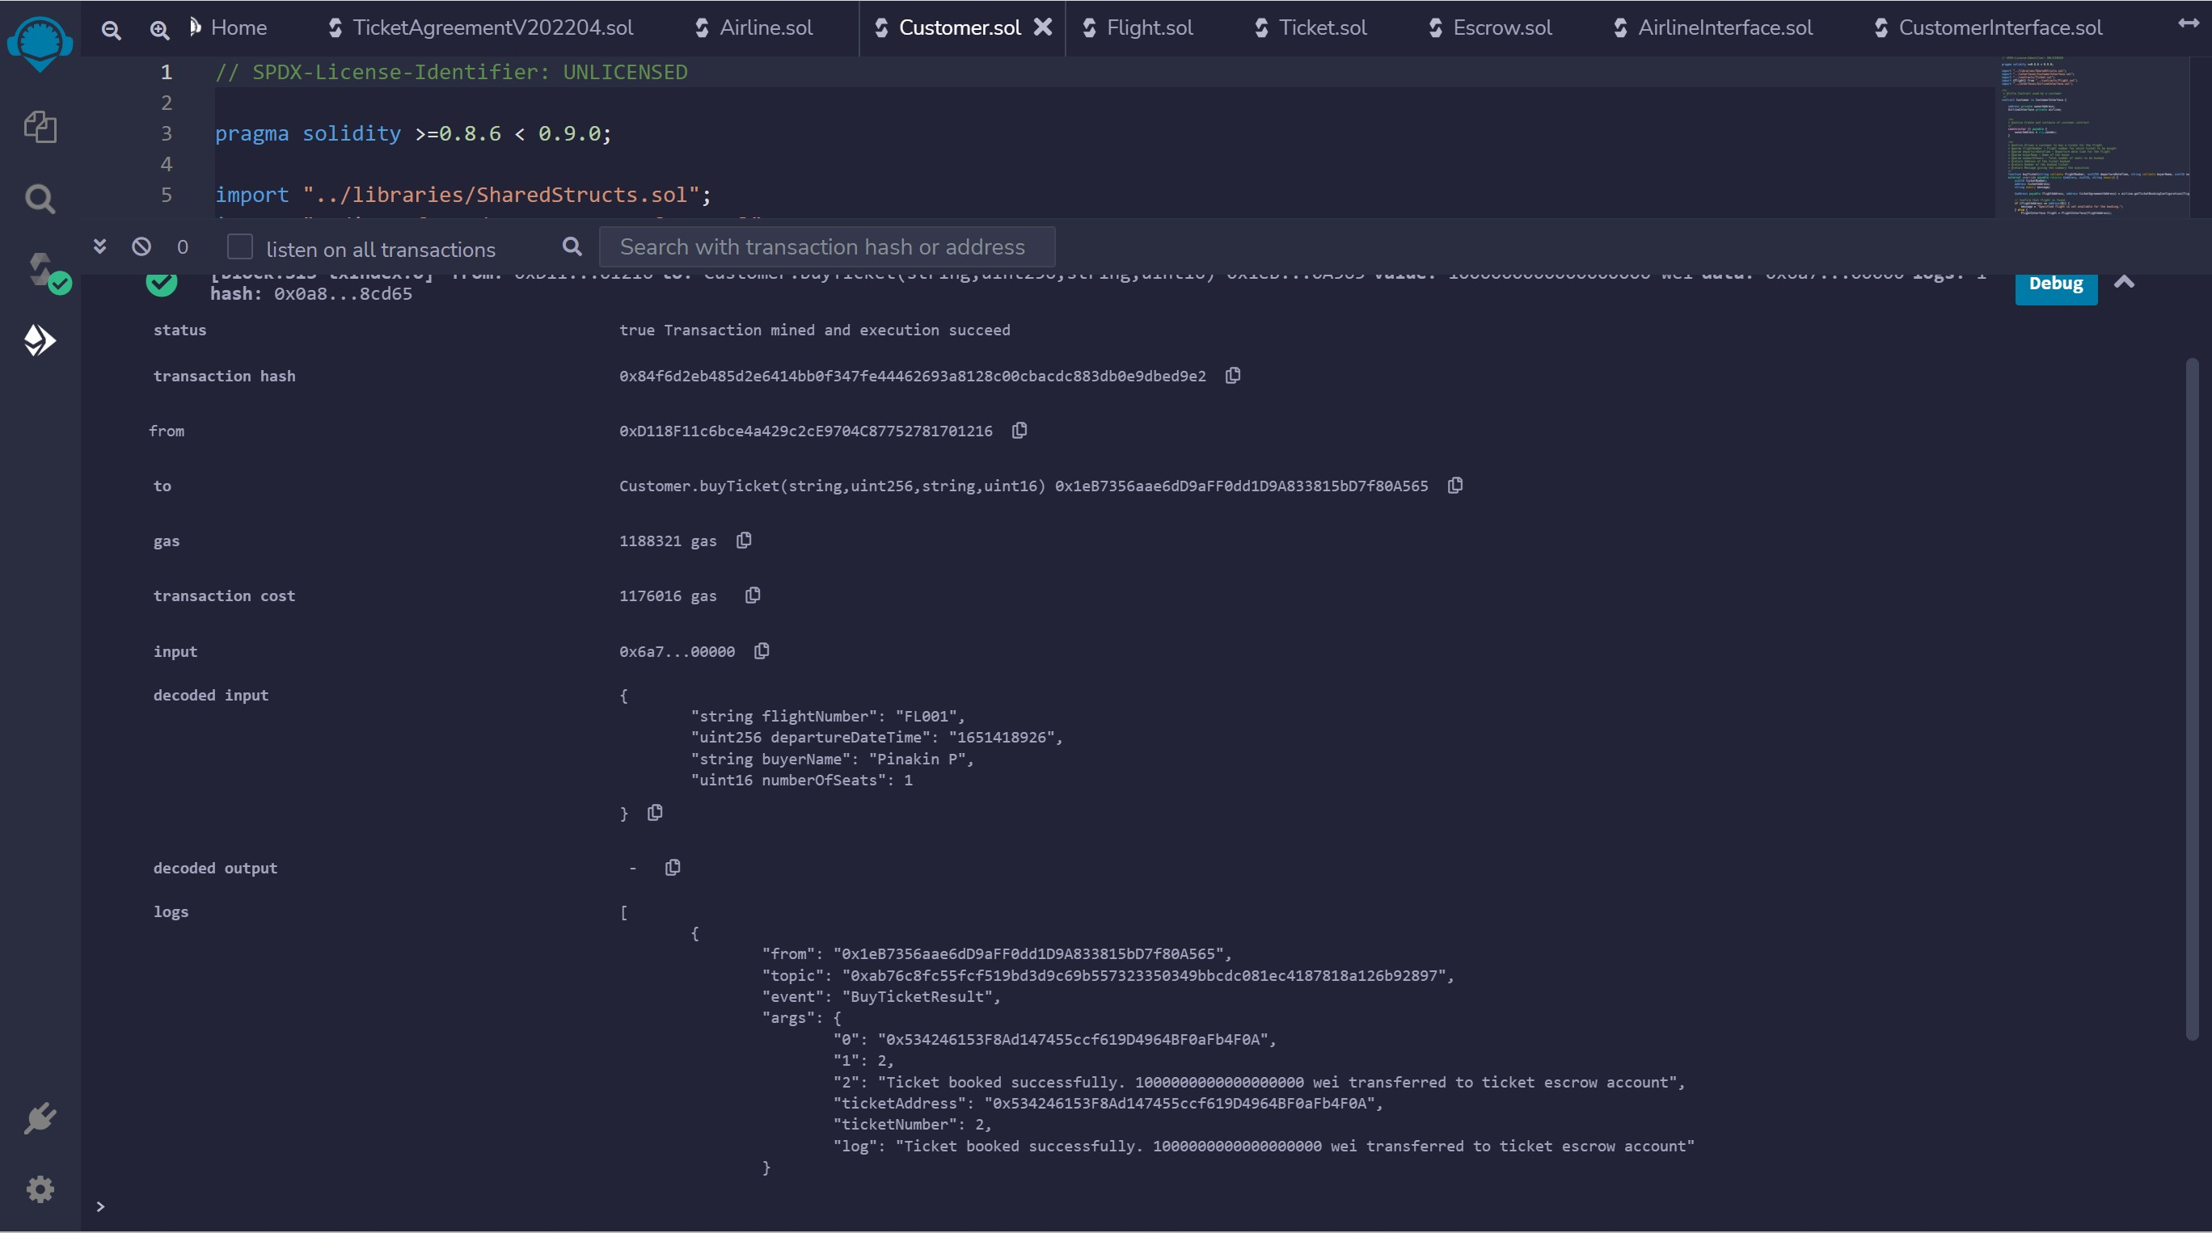
CUSTOMER BUY TICKET - TXN

Slide 33
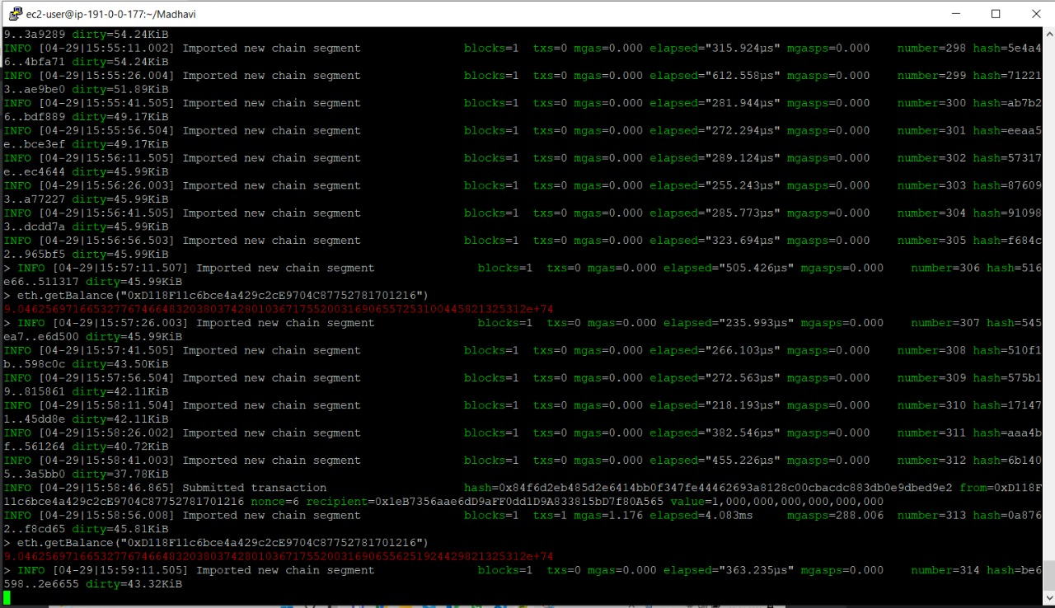
CUSTOMER BALANCE – AFTER TXN

Slide 34
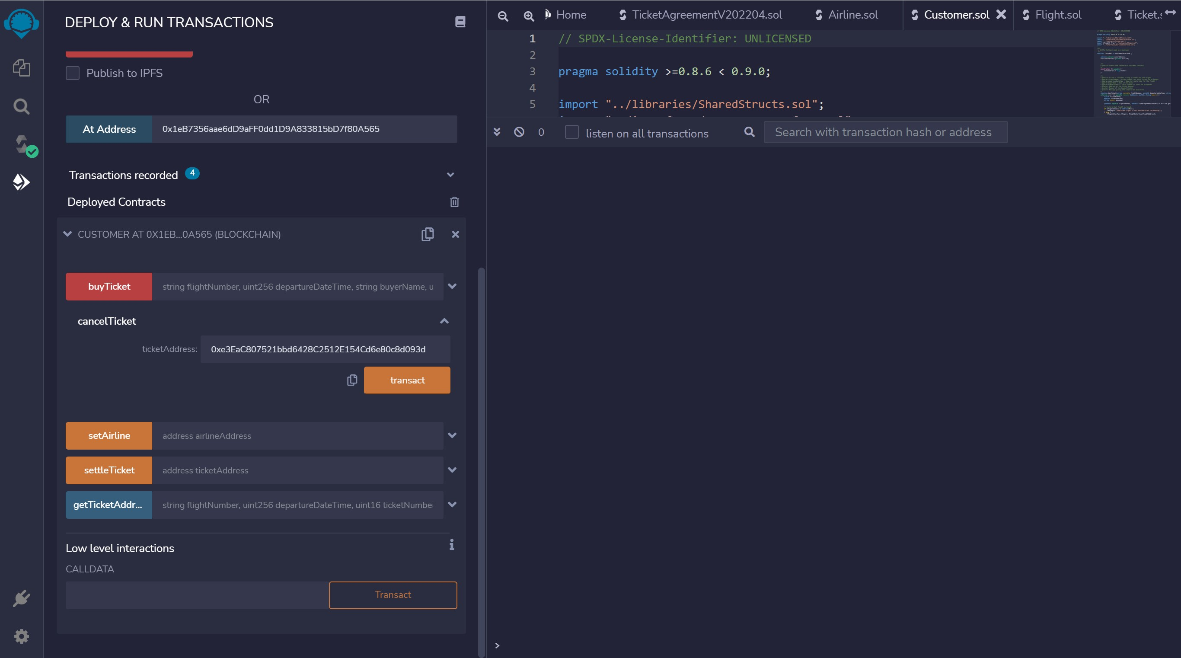
CUSTOMER CANCEL TICKET

Slide 35
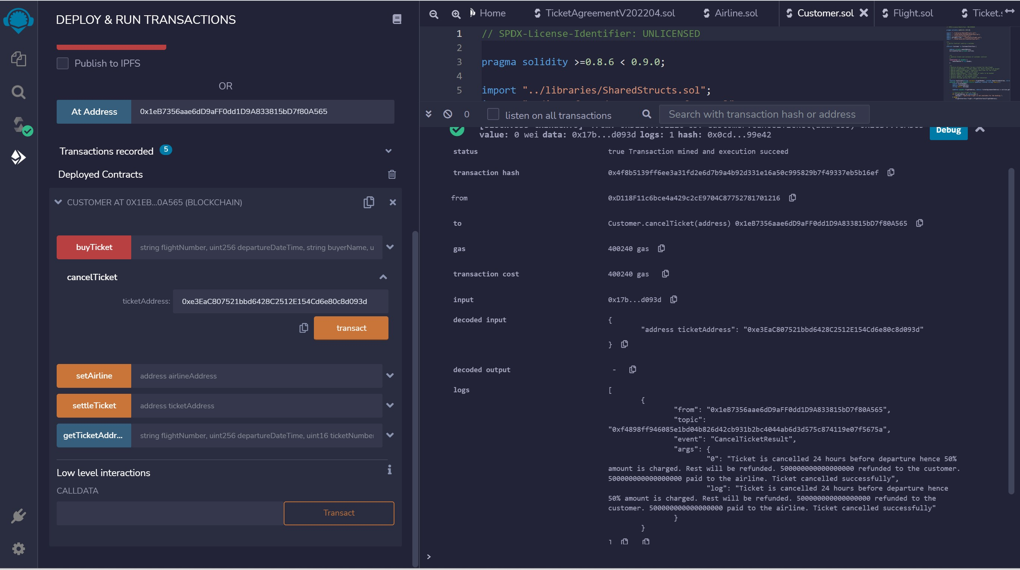
CUSTOMER CANCEL TICKET - TXN

Slide 36
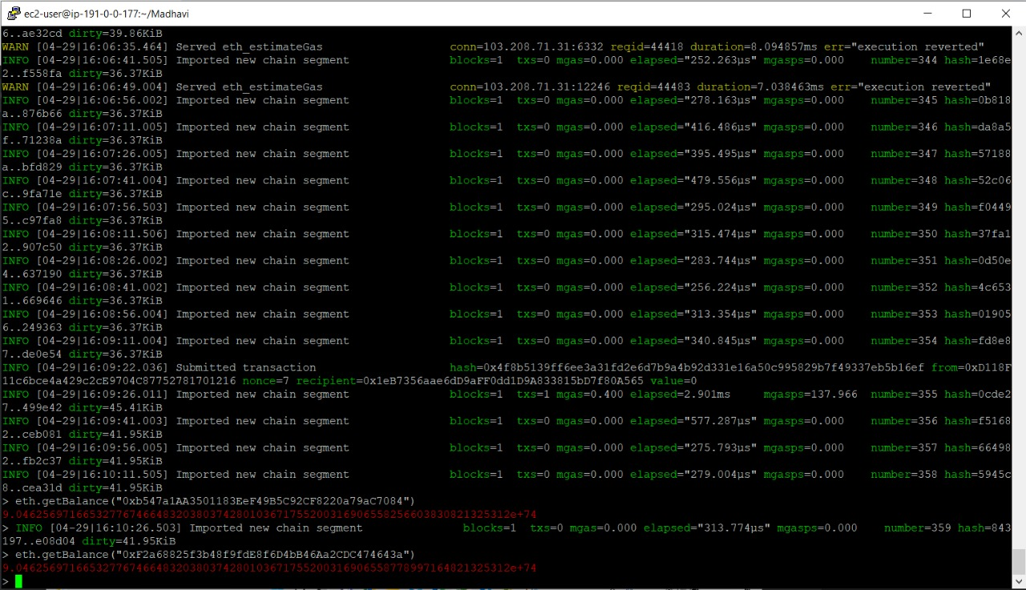
GET BALANCE AIRLINE ACCOUNT MINER 2

Slide 37
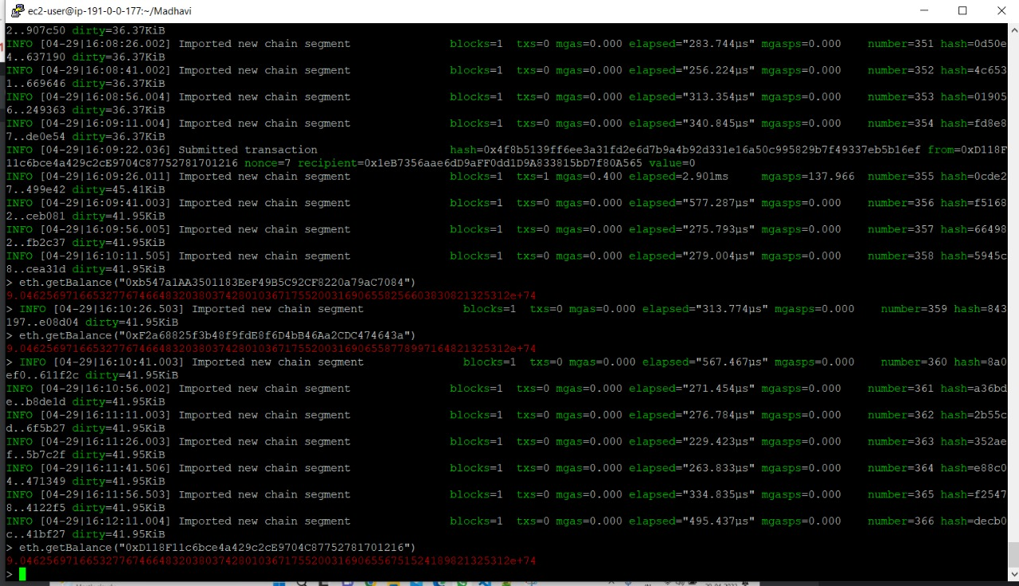
CUSTOMER GET BALANCE

Slide 38
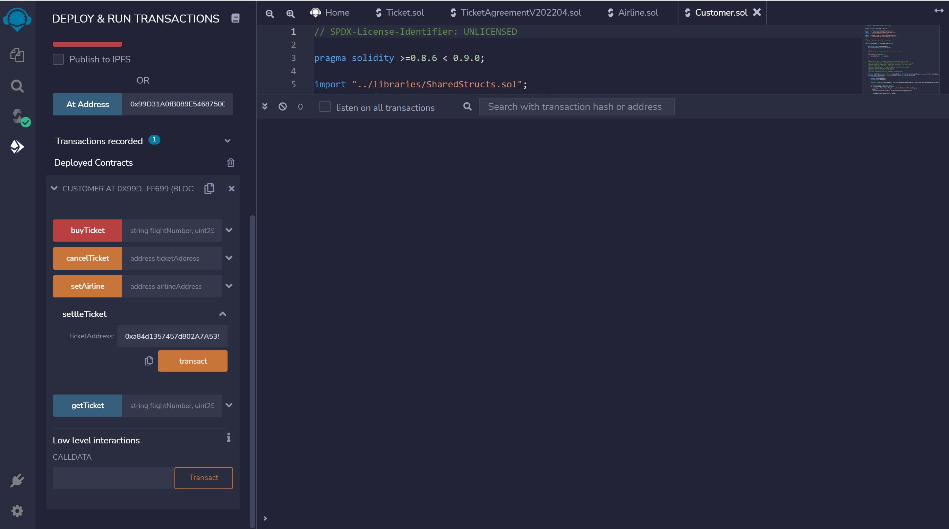
CUSTOMER SETTLE TICKET

Slide 39
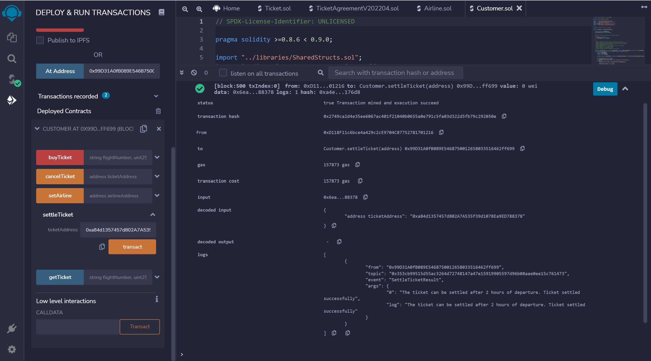
CUSTOMER SETTLE TICKET -TXN

Slide 40
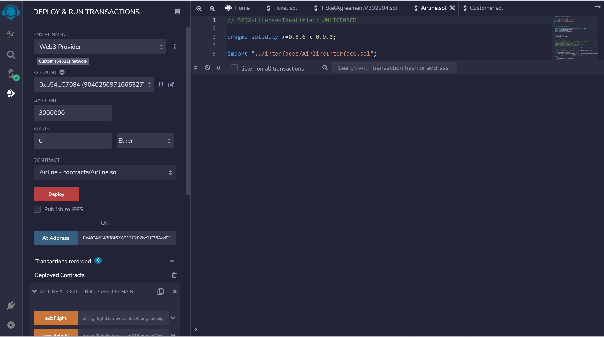
CONNECT TO AIRLINE MINER ACCOUNT 1

Slide 41
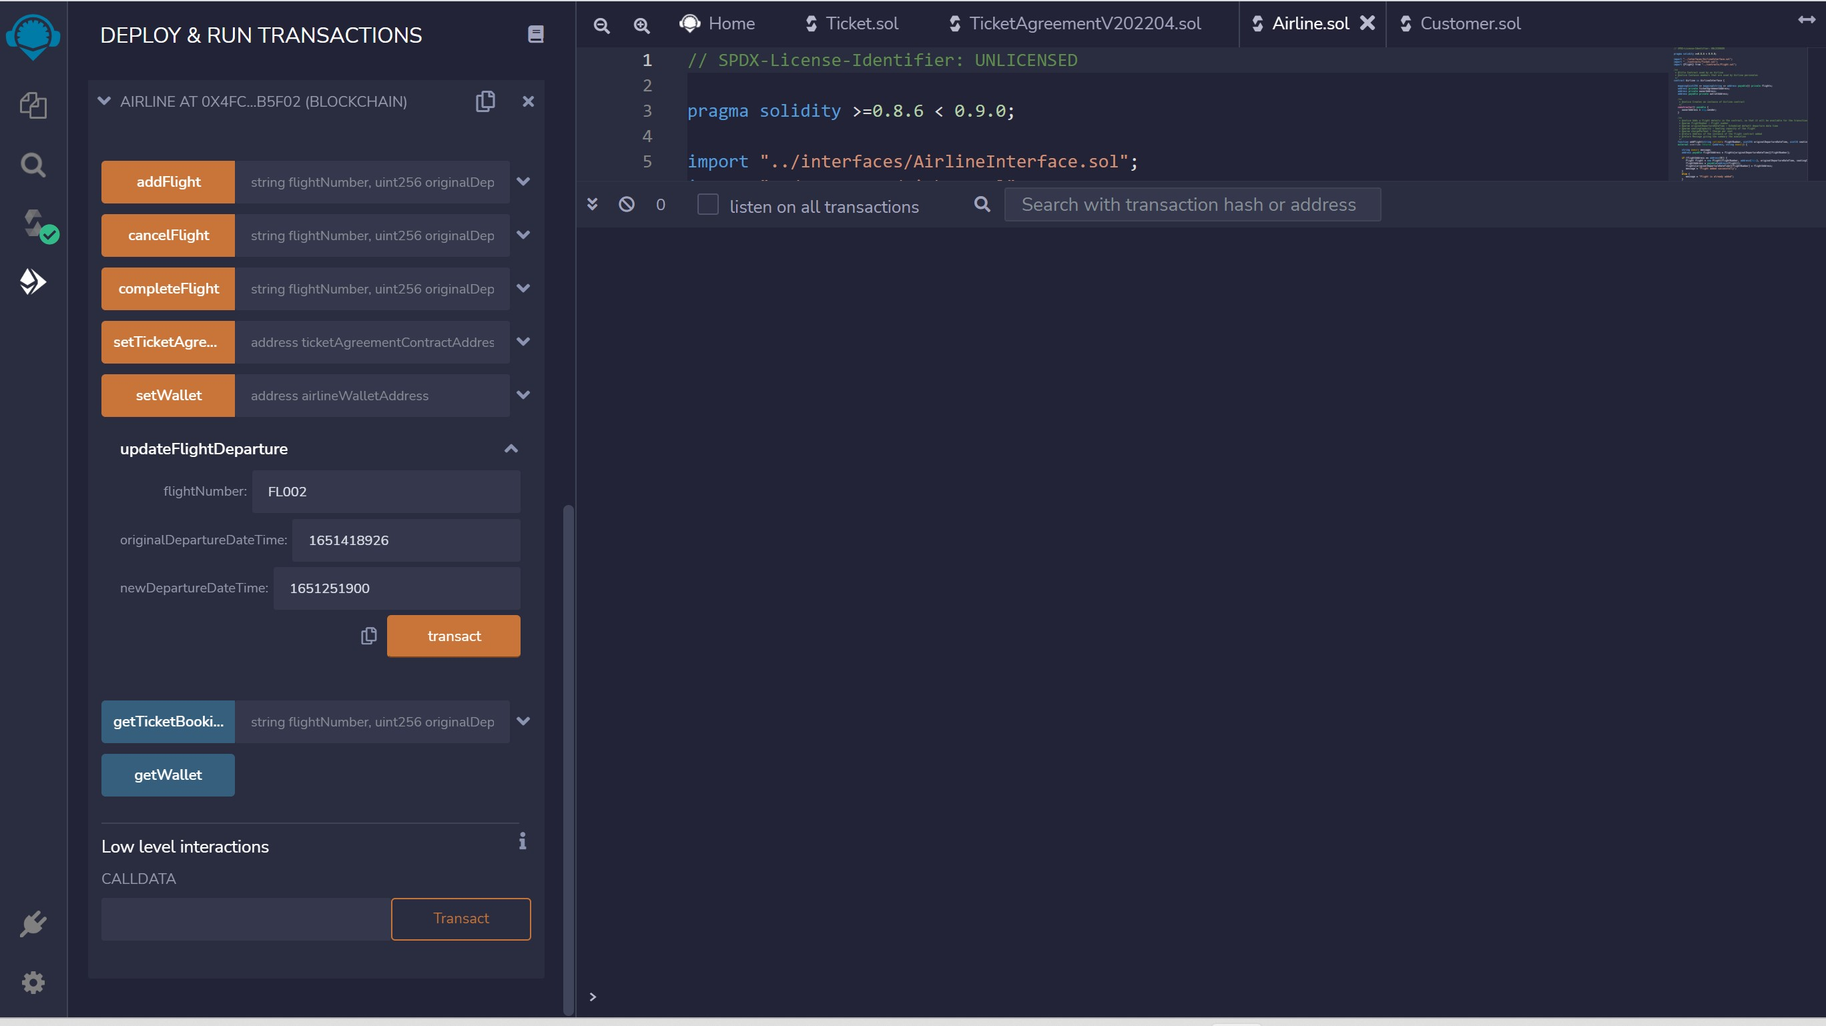
AIRLINE UPDATE DEPARTURE

Slide 42
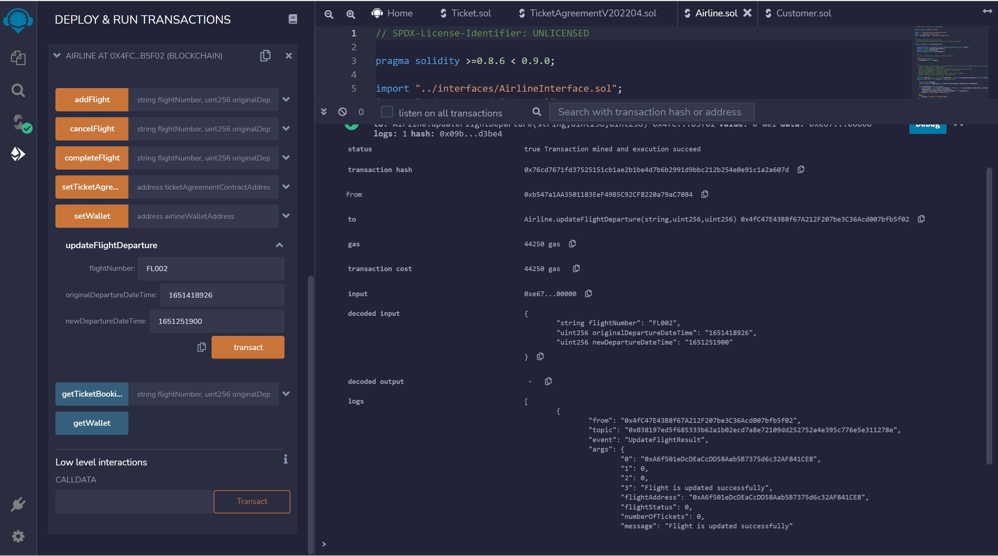
AIRLINE UPDATE DEPARTURE - TXN

Slide 43
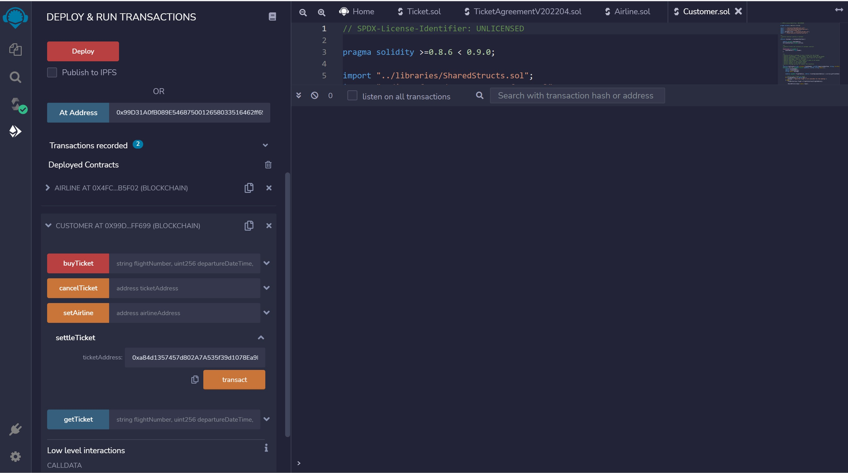
CUSTOMER SETTLE TICKET

Slide 44
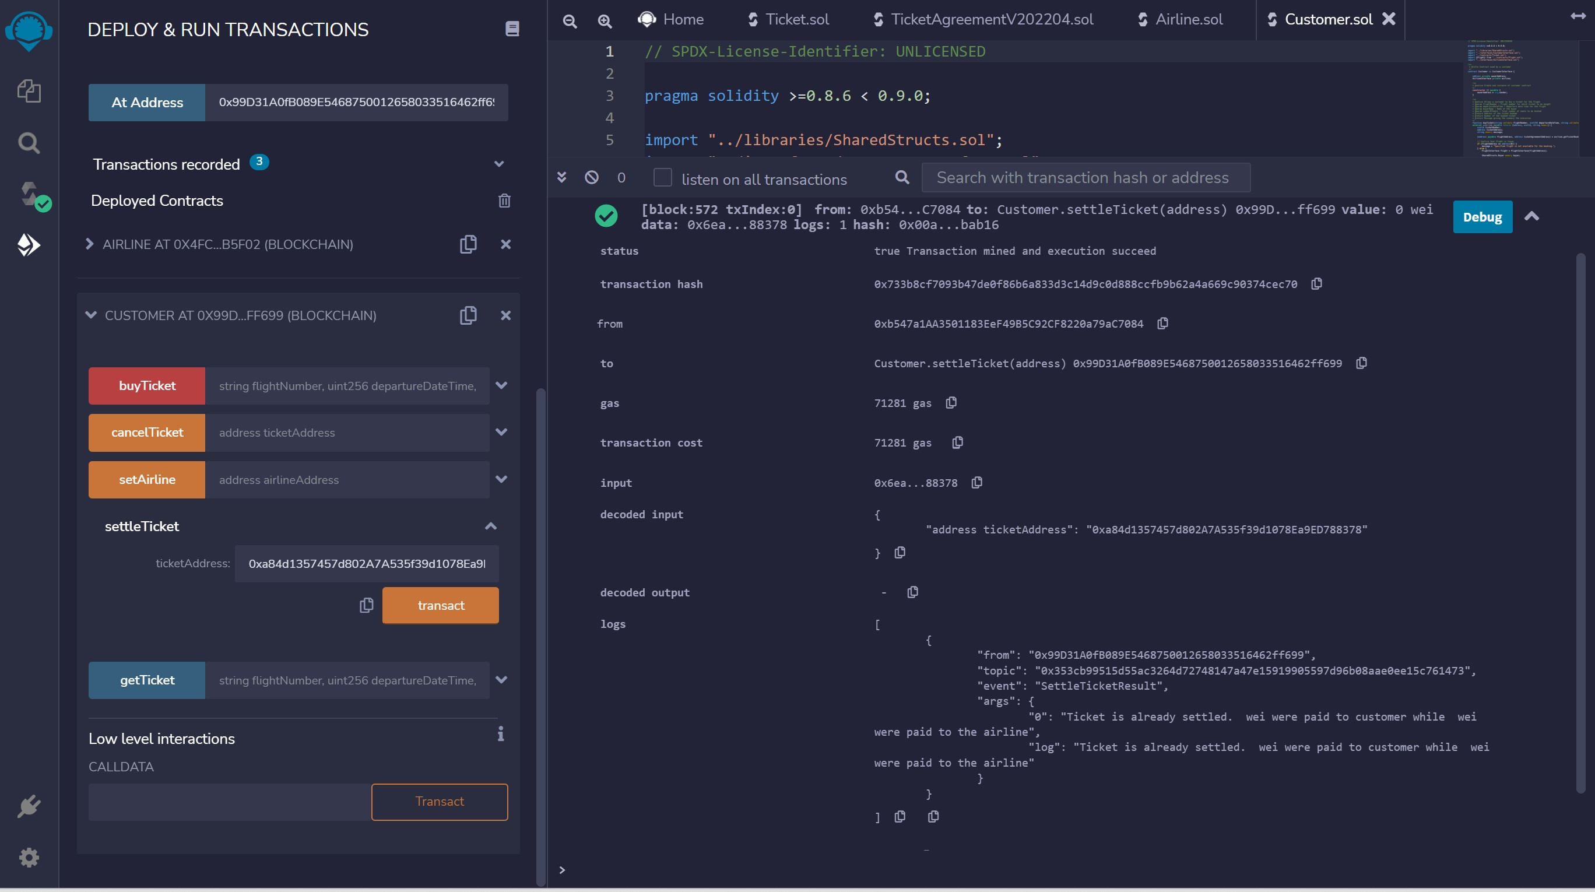
CUSTOMER SETTLE TICKET - TXN

Slide 45
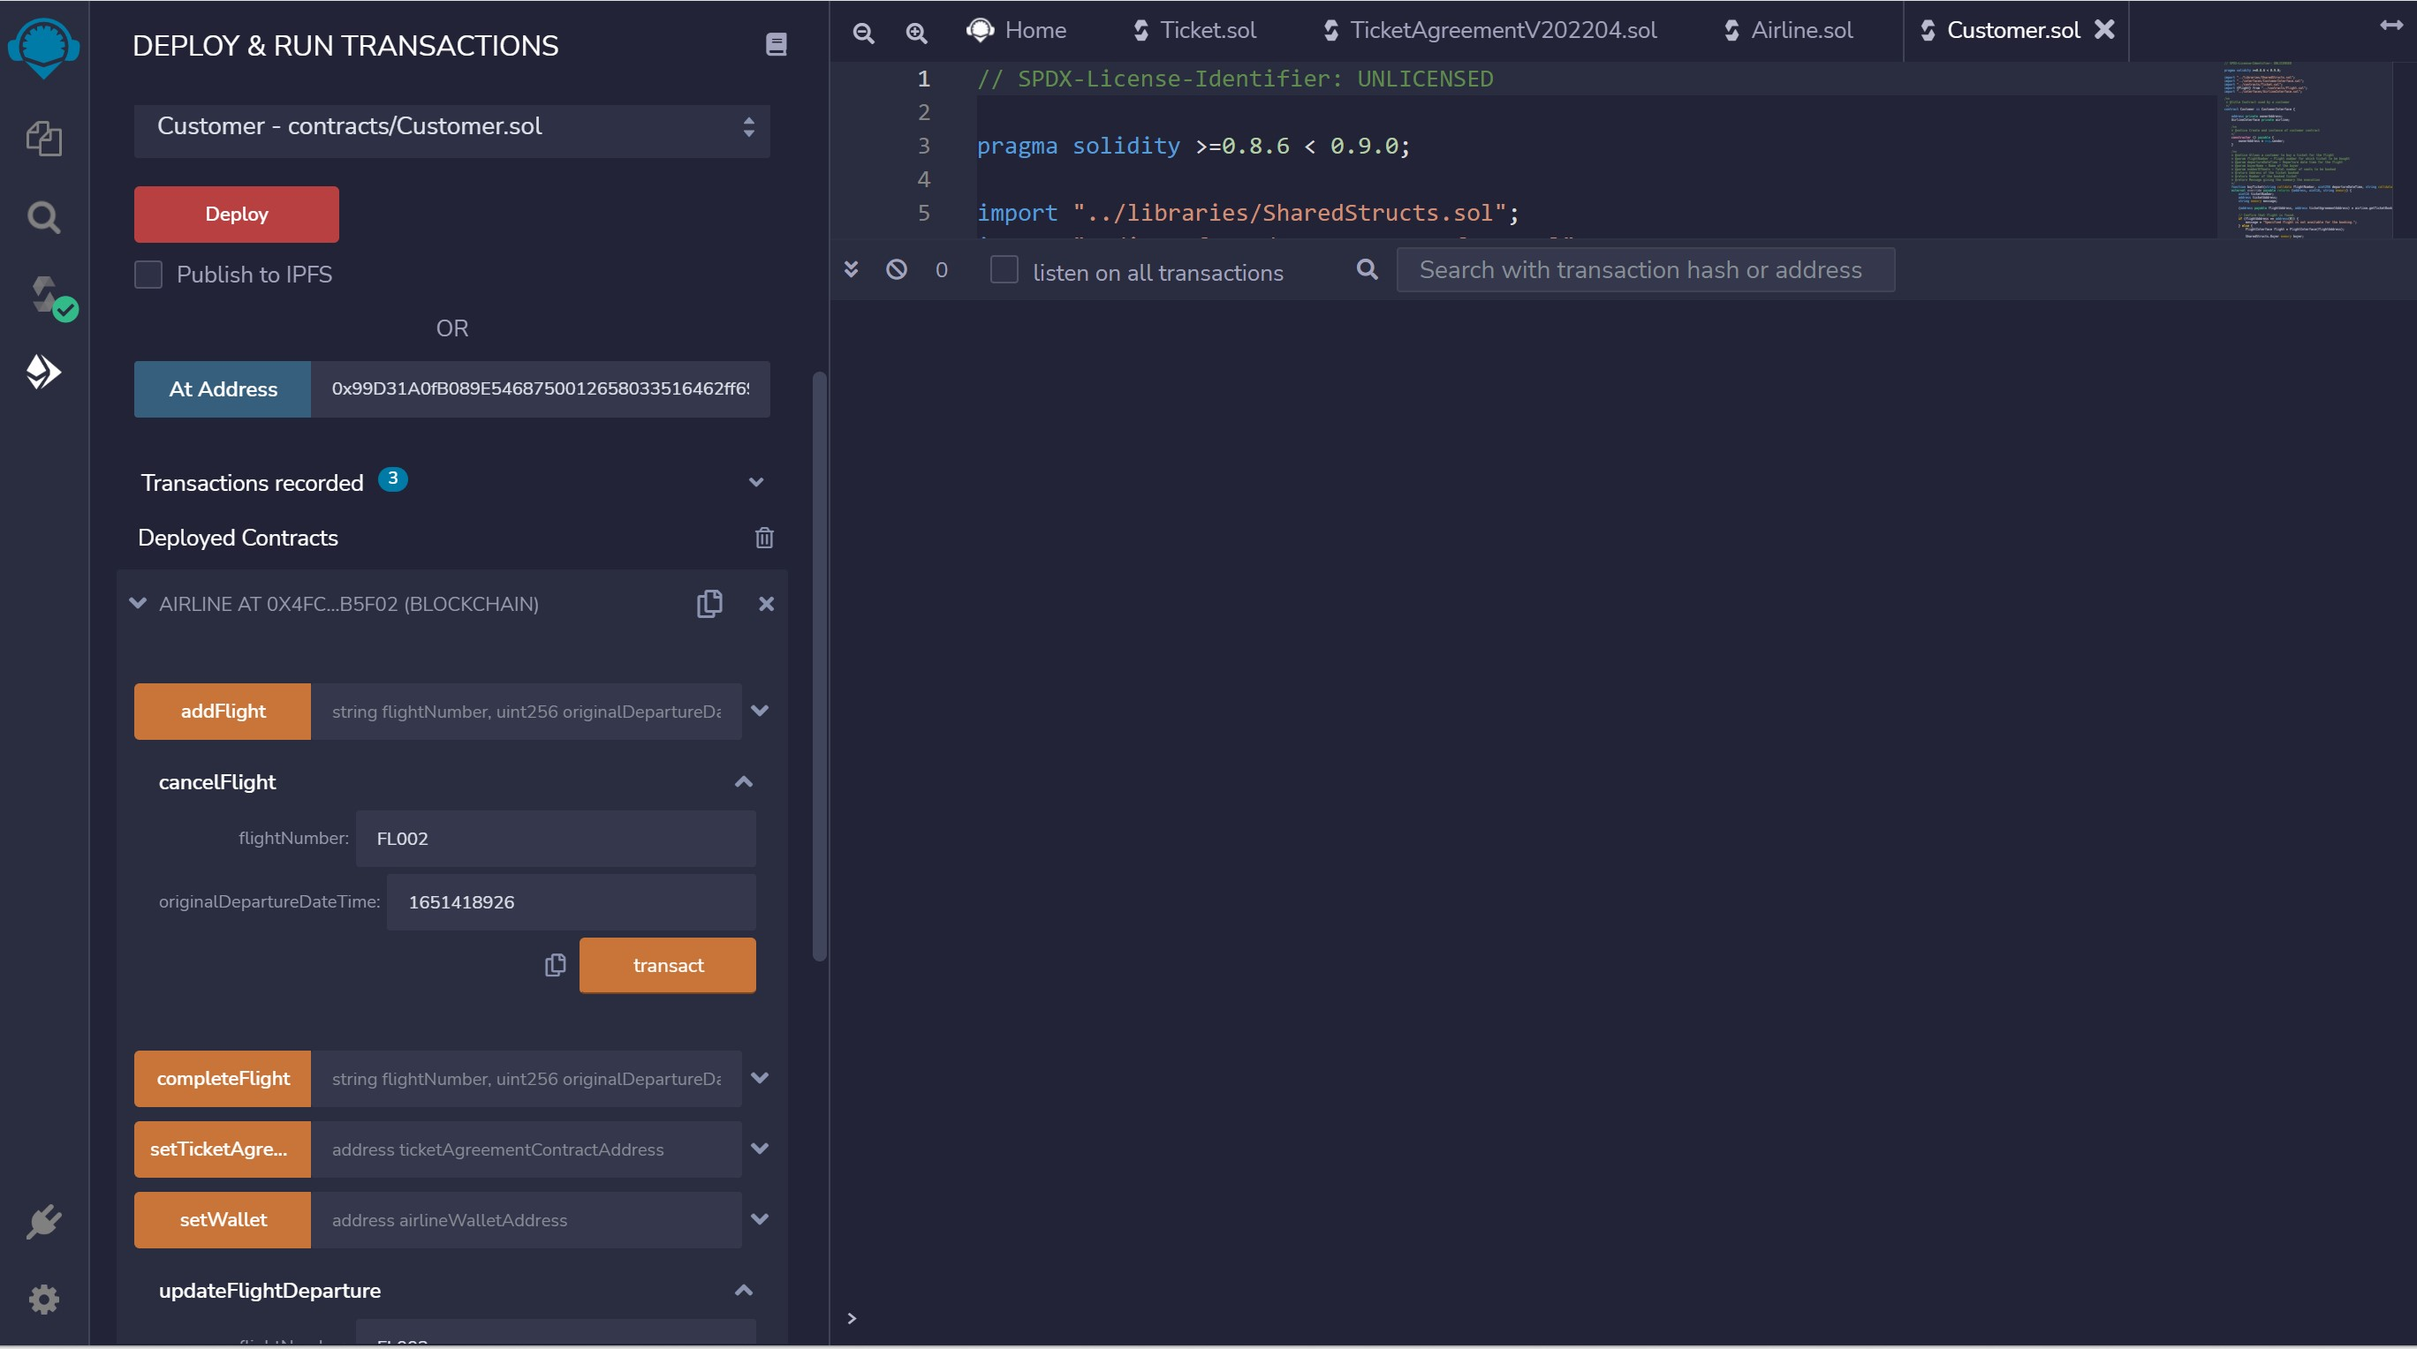
AIRLINE CANCEL FLIGHT

Slide 46
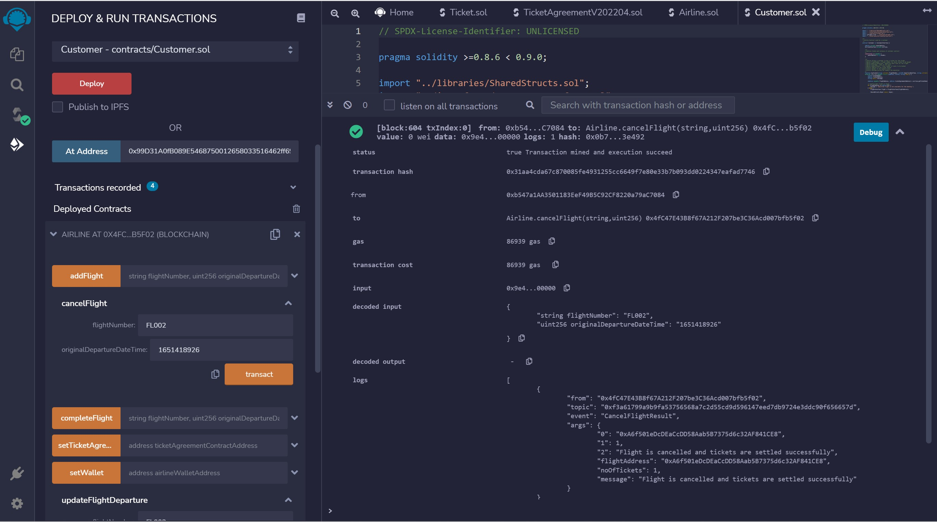
AIRLINE CANCEL FLIGHT - TXN

Slide 47
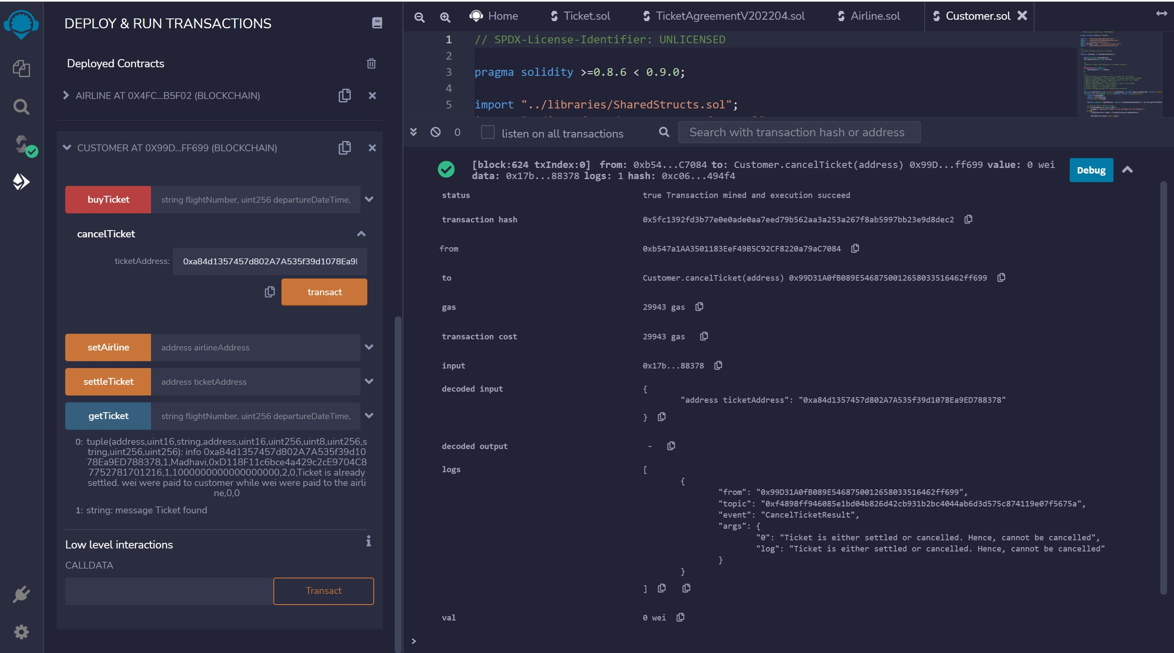
CUSTOMER CANCEL TICKET - TXN

Slide 48
PENDING TESTCASES
CHAINLINK INTEGRATION FOR FLIGHT INFORMATION
REFUND CALCULATION FOR DELAYED FLIGHT

Slide 49
Thanks

